Slide 1
Physical and physio-chemical factors affecting metal precipitation:
The physical factors represent by the above-mentioned opening. While the physio-chemical factors include:
1-Temperature 2-Pressure 3-Solubility of metal complex
4-The ratio of metal available to the sulfur species
5-The nature of the host rocks 6-Changes in the (pH and Eh )

Slide 2
Types of processes of hydrothermal ore deposition:
(A) Cavity Fillings (open space filling):
At shallow crustal levels ore deposition will take place by open space filling. In addition, the resulted ore-deposits will be names after the filled cavity (Figure 5):
1-Fissure veins ore-deposits 2-Shear-zone ore-deposits
3-Stock works ore-deposits 4-Saddle reefs ore-deposits

Slide 3
5-Ladder veins ore-deposits
6-Pitches and flats ore-deposits
7-Breccia filling ore-deposits (volcanic, collapse and tectonic)
8-Solution cavity filling ore-deposits (cave, channel and gash)
9-Pore space ore-deposits
10-Vesicular filling ore-deposits

Slide 4
(B) Replacement:
Replacement of existing minerals tends to occur at deeper down the crust where porosity is restricted. Decrease in temperature is the factor that is regarded.
Hydrothermal ore-deposits formed by replacement are:
1-Massive ore deposits
2-Replacement lode ore-deposits
3-Disseminated replacement ore-deposits

Slide 5
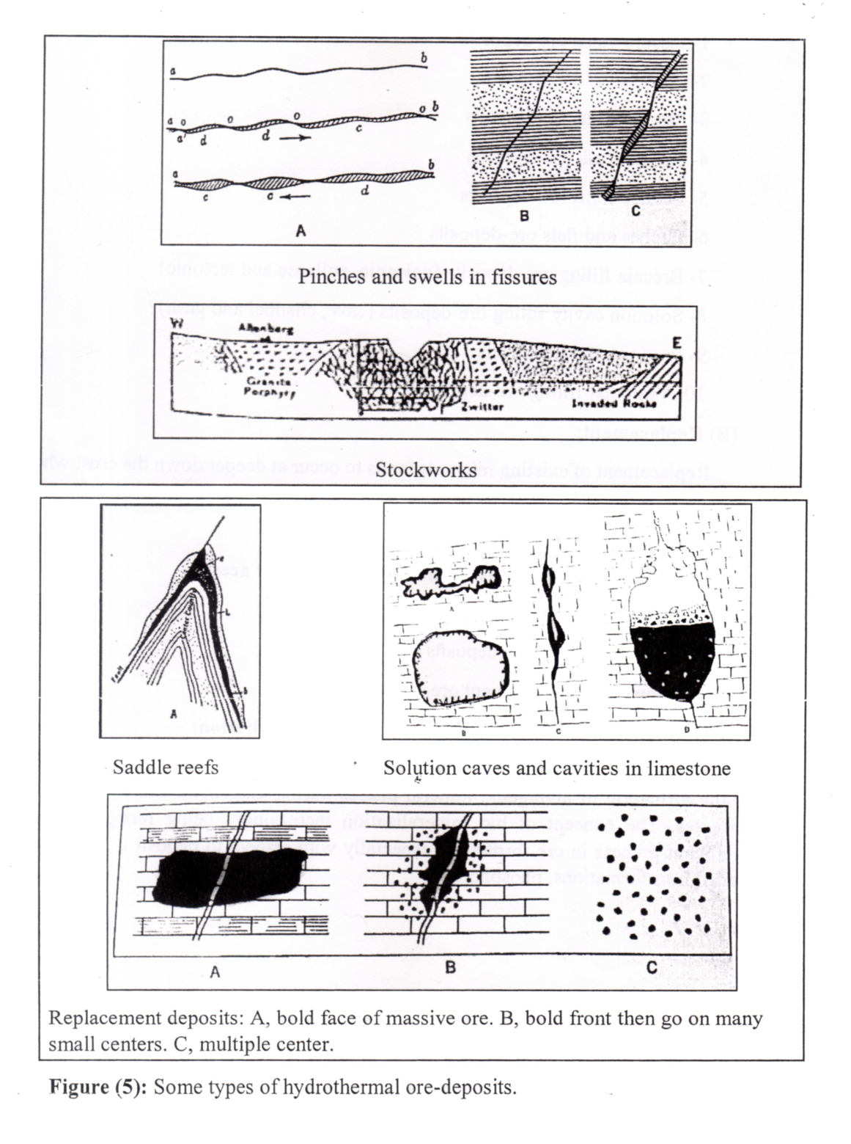

Slide 6
(C) Biologically mediated processes of metal precipitation:
The interaction of microorganisms with a variety of other metals is also important for the formation of authigenic mineral phases during diagenetic and hydrothermal processes. The concept of bio mineralization increasingly being recognizes as a significant process in ore formation, especially with respect to deposit types such as banded iron-formations, phosphorites.

