Slide 1
How can do these
application in windows7.

Slide 2
View the content of a folder
Viewing and arranging files and folders.
Each time you click the Views button, the folder window changes the way it displays your file and folder icons, alternating between large icons, a smaller icon view called Tiles, and a view called Details that shows several columns of information about the file.

Slide 3
View the contents of the Recycle Bin
Recycle Bin icon:-
contains files and folders that you delete. The deleted files are not gone until you empty the Recycle bin.
Double click the Recycle bin to view the contents.

Slide 4
Open an object’s shortcut menu.
Right-click an object opens it’s shortcut menu.
Active a window that is covered by other windows using the task bar.
By clicking the program icon.

Slide 5
View an application icon for each open window
Right-click an open area of taskbar select properties click never combine on the taskbar buttons list box ok.
Add toolbars to the taskbar
Right-click on an area of the taskbar point to toolbar
and select the toolbars you wish to use a check mark appears next to
Toolbars that active on taskbar.

Slide 6
Open the jump list , when applications are open on desktop.
Right-click the program icon on the taskbar to open
The jump list.
Remove pinned applications from the taskbar
Right-click of the program icon And selecting
unpin this program from the taskbar.

Slide 7
Open Notification
By clicking on the open action center link.
Show the pop_up window to display information
By clicking action center icon on the taskbar displays the information.

Slide 8
Personalize the window
By right-click on an empty potion of the desktop
select personalize to open this window.
minimize the window
Press the control button on the right side of tittle bar.
maximize the window
Press the control button on the right side of tittle bar.

Slide 9
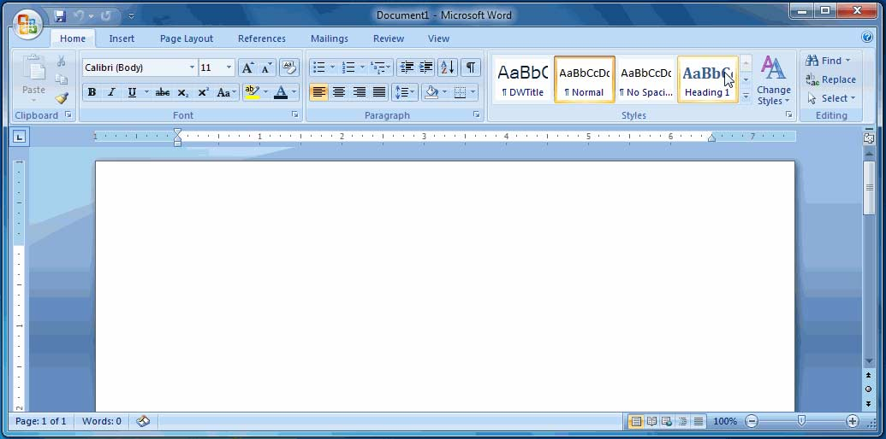
close the window
Press the control button on the right side of tittle bar.
Minimize window
Maximize window
Close window

Slide 10
Places automatically window on the side of the disk top (use snap tool in window7)
Click and drag the tittle bar of the window to the left or right
Side of the disk top until an outline of a window appear.

Slide 11
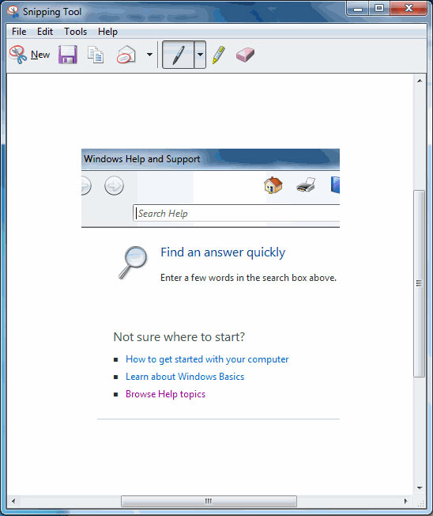
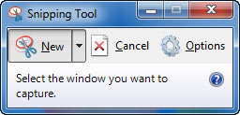
Save Snip button
Annotation
tools
Screen clip

Slide 12
arrange the windows in a cascading fashion
Right-click on an empty portion of the taskbar the
Configuration you want to use 1.cascading
2.vertically
3.side to side
you can cycle through all Open windows.

Slide 13
Place sticky notes on your desk top
start button all programs accessories sticky notes.
To add or open anew note click(+ sign) in upper left corner of the sticky .
To delete a note click the delete note button in the upper right corner of the note.
To change the color of the note right click on the body of the note and select the color.

Slide 14
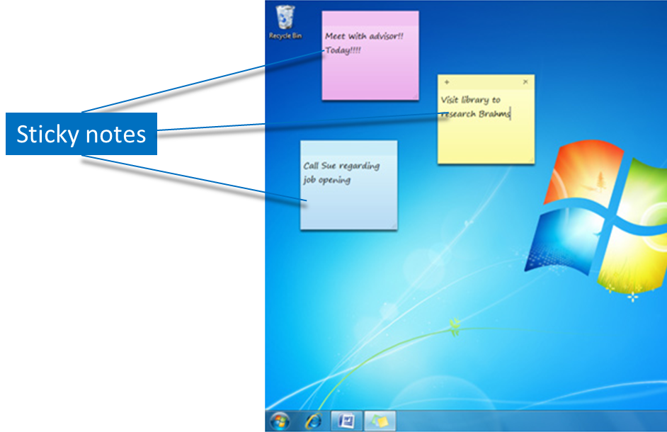

Slide 15
Access Note pad or Word pad ,Paint
start button all programs accessories select either Note pad or Word pad.
Save your work of arts on Paint
Click save button at top of the window. To save the painting.

Slide 16
How many security settings and software windows7 providing you write the names of it :-
6 software.
Action center.
windows update.
windows firewall.
windows defender.
user account control.
parental controls.

