Slide 1
Internet Services & Web Technologies

Slide 2
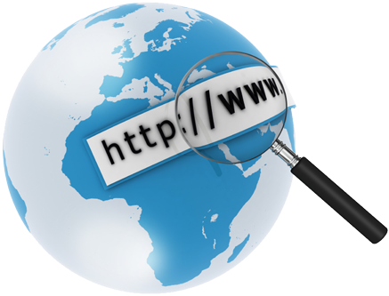

What is the Internet

Slide 3
Terms to know
Internet= Inter-connected Networks
The term “internet” refers to the Hardware (cables, fiber, computers. phone lines routers ,etc. It’s a network for computers. It connects computers all over the world.
Web Browser= The software used to view web pages
Microsoft Internet Explorer
Mozilla Firefox
Google Chrome
Web Page= A single screen of data.
Website= All related web pages for an organization or individual.
Home Page= First page of a website (the filename is usually index.htm)
Web Server= A web server is a specific type of computer where web pages are stored and made available for public viewing.

Slide 4
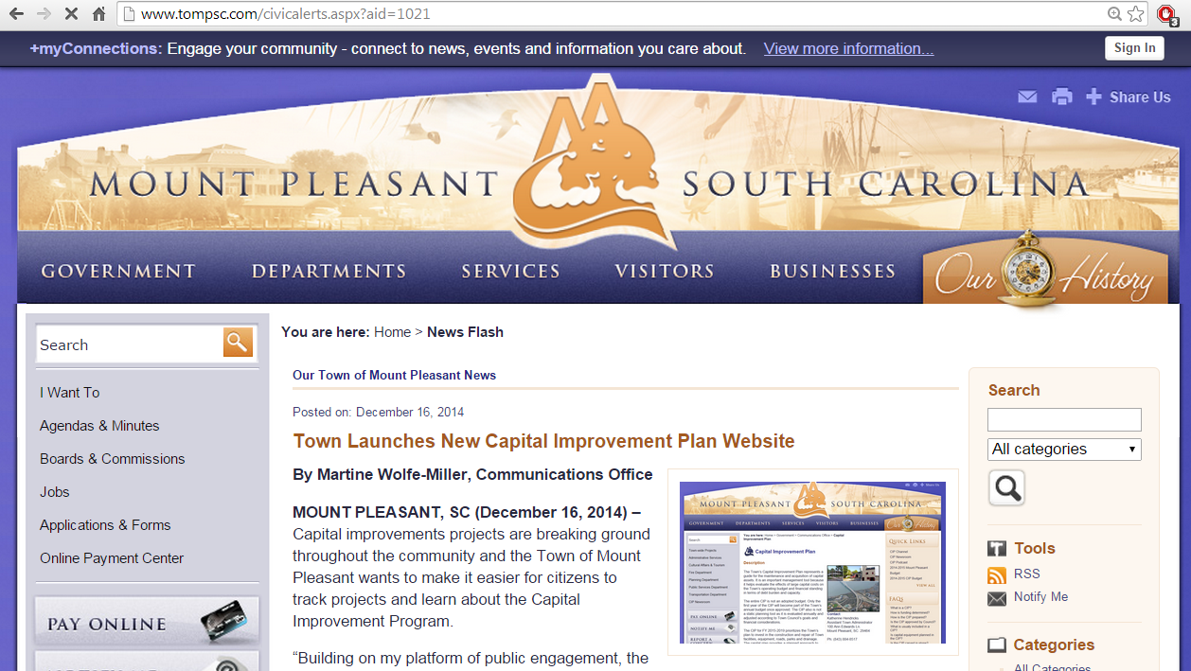
Web Page & WEBSITE

Slide 5
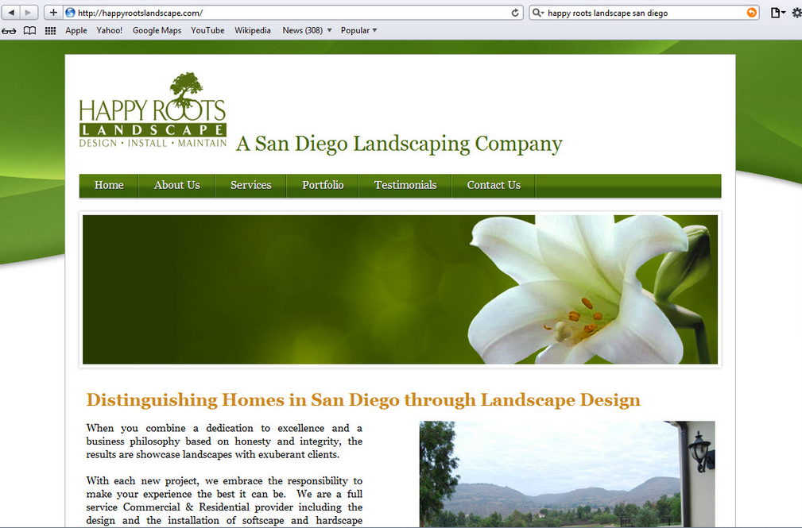
Home Page

Slide 6
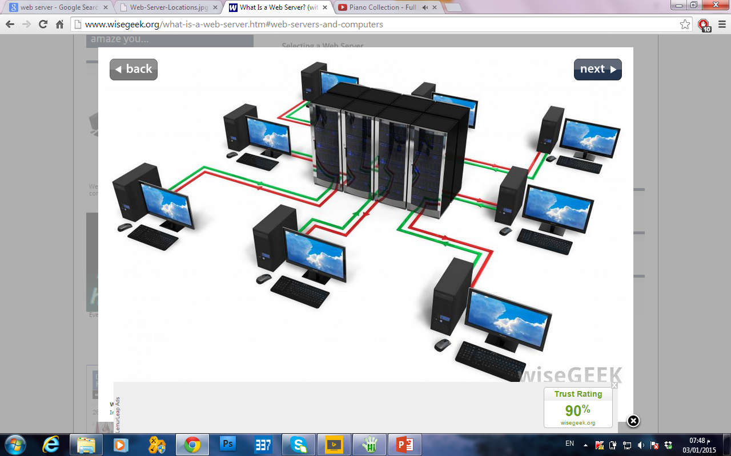
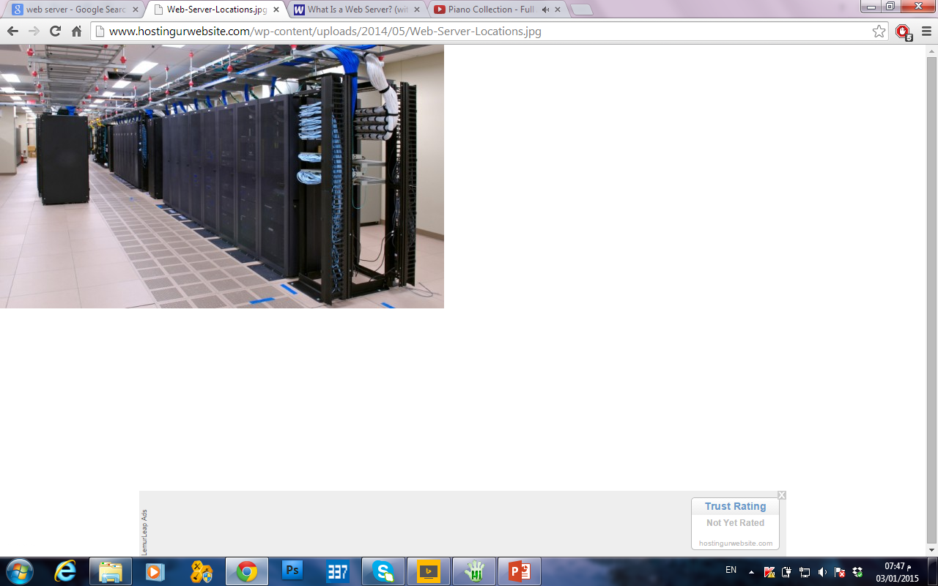
Web Server

Slide 7
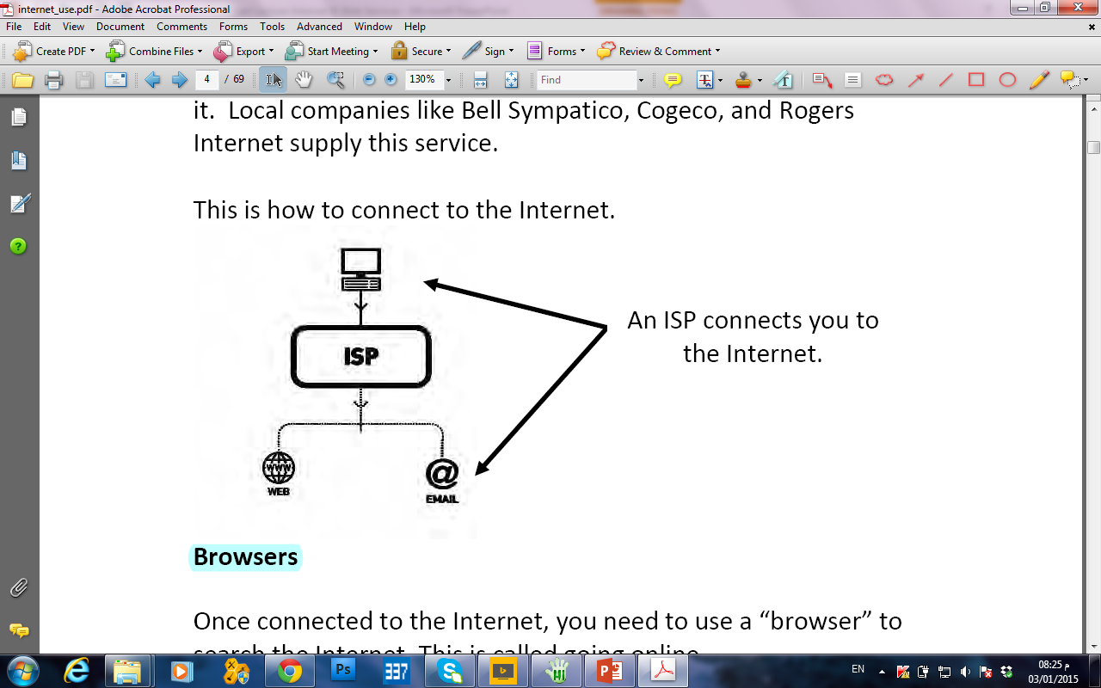
Internet Providers
You need an Internet Service Provider (ISP) to connect to the Internet. You will not be able to connect to the Internet without it. Local companies like Bell Sympatico, Cogeco, and Rogers Internet supply this service. This is how to connect to the Internet.

Slide 8
IP Addresses
IP Addresses
A number that uniquely identifies each computer or device on a network
A series of four numbers separated by a period or dot
167.68.24.104
Static IP addresses seldom change
Dynamic IP addresses are temporary

Slide 9
Domain Name
Every document on the web has an address which is called the URL (Uniform Resource Locator). Each URL has several parts: the protocol, the host name and domain name.
The URL to locate GOOGLE is http://www.google.com
http:// and https:// hypertext transfer protocol identifies the document as a web page. It is the standard used to connect, communicate and transfer data on the Web.
www document on the World Wide Web. Not all web sites require this.
.google host name
.com domain name that identifies category of the page. Other typical domain names include: gov - Government agencies; edu - Educational institutions; org - Organizations (nonprofit); mil – Military; com - commercial business; net – Network Organizations; ca – Canada, etc..

Slide 10
HTML = The basic code of web pages.
HTTP= Hyper-Text Transfer Protocol
A protocol is a set of rules. HTTP is the rules for transferring files over the web.
URL= Uniform Resource Locator, the address of a web page.
Parts of A URL
http://mybusiness.com/catalog/shoes/nike.htm
http:// (protocol)
mybusiness.com the website domain name
/catalog/shoes folders of the website
/nike.htm filename of web page

Slide 11
to Summarize
A web page is a document written in HTML format and saved on a web server.
HTML documents use HTTP protocol to transfer the files.
Web browser must be used to view a web page, because browsers display HTML formatted documents and use HTTP protocol.

Slide 12
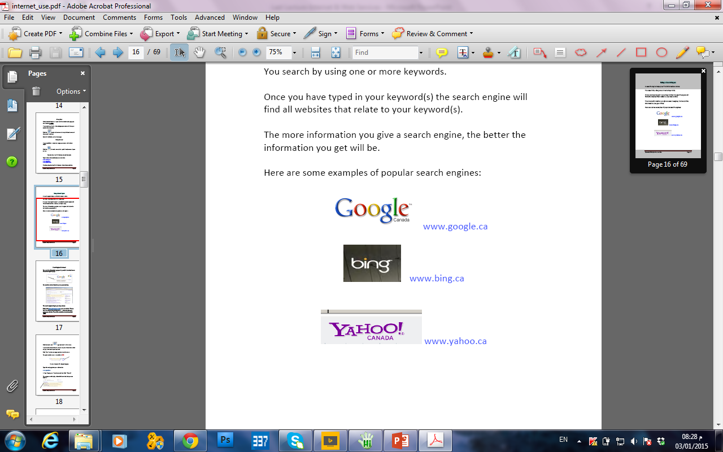
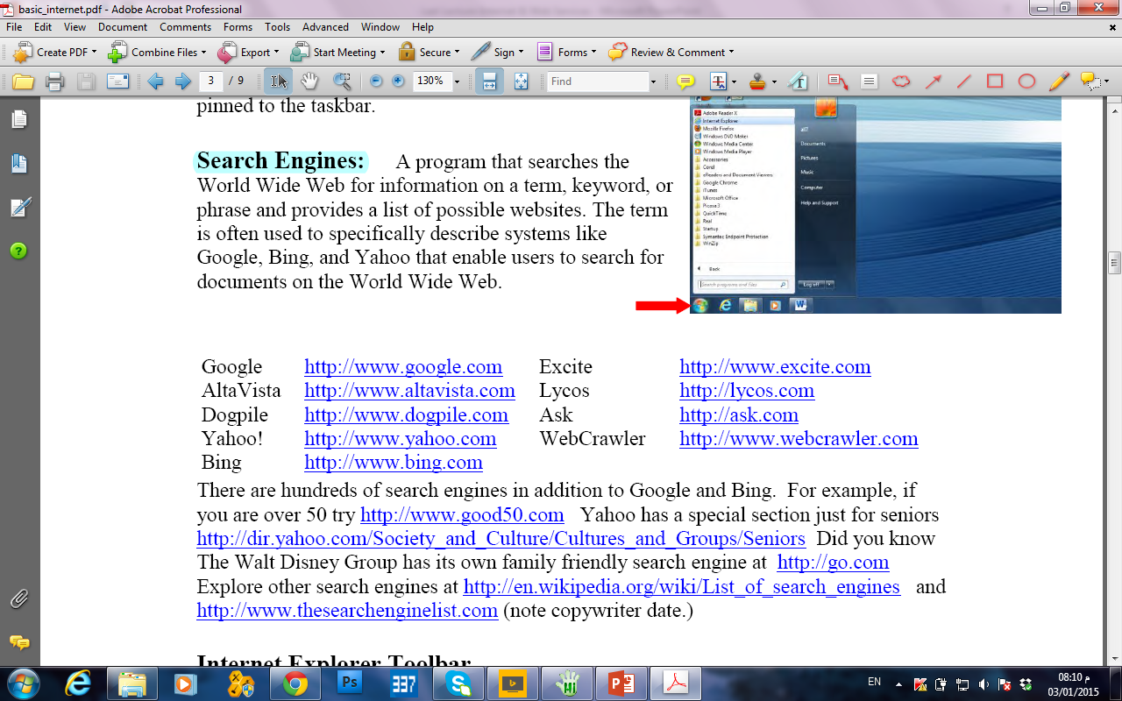
Search Engines
A program that searches the World Wide Web for information on a term, keyword, or phrase and provides a list of possible websites. The term is often used to specifically describe systems like Google, Bing, and Yahoo that enable users to search for documents on the World Wide Web.

Slide 13

Advantages of the Internet:

Slide 14
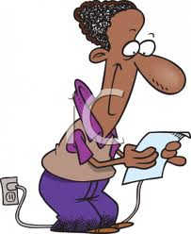

E-mail:
Send and receive instant electronic messages

Slide 15

Access Information:
The Internet is a virtual treasure of information.

Slide 16

Shopping:
You do not need to leave your house

Slide 17
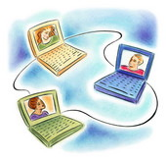
Online Chat:
There are many ‘chat rooms’ on the web.

Slide 18

Downloading Software:
This is one of the most happening and fun things to do via the Internet.

Slide 19
Disadvantages of the Internet:

Slide 20
▪ Personal Information:
Your personal information can be accessed by other people.
Your credit card information can also be ‘stolen’.

Slide 21
▪ Spamming:
This refers to sending unsolicited e-mails in bulk, which serve no purpose

