Slide 1
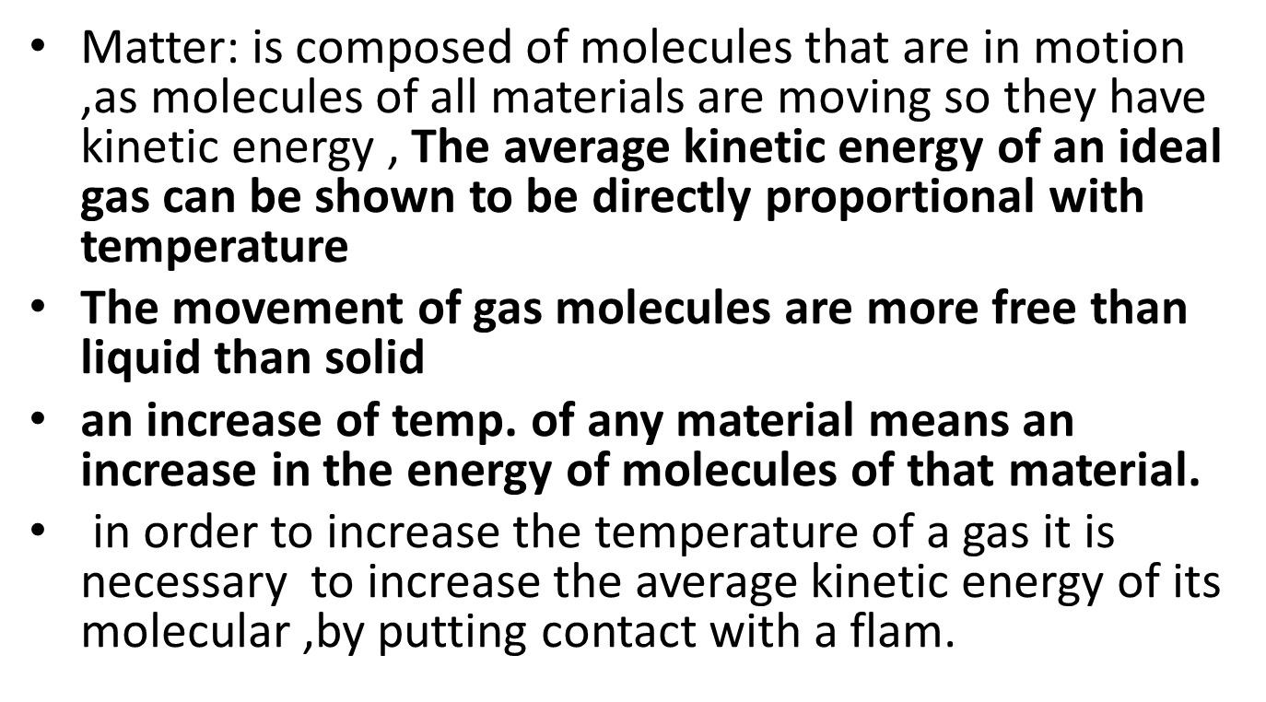
Department of:
HERE
Physical basis of heat and temperature

Slide 2
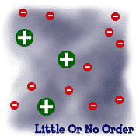



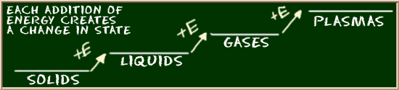
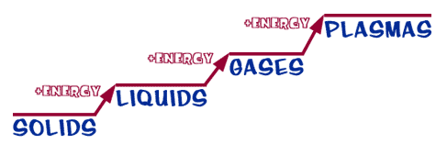
STATES OF MATTER
SOLID
LIQUID
GAS
PLASMA
Tightly packed, in a regular pattern
Vibrate, but do not move from place to place
Close together with no regular arrangement.
Vibrate, move about, and slide past each other
Well separated with no regular arrangement.
Vibrate and move freely at high speeds
Has no definite volume or shape and is composed of electrical charged particles

Slide 3
Heat: is the total energy of molecular motion in a substance .
Temperature :is a measure of the average energy of molecular motion in a substance.
Heat energy depends on the speed of the particles , the number of the particles (size or mass).and the type of particles in an object .
Temperature dose not depend on the size or type of object ,the temperature of small cup of water might be the same as the temperature of a large cub of water but the large cub of water has more heat because it has more water and thus more total thermal energy ,higher temperature means that the molecular are moving , vibrating and rotating with more energy.

Slide 4
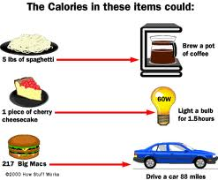
How is heat measured?
Heat is measured in two ways.
One way is the calorie (cal)
One calorie is equal to the amount of energy needed to raise the temperature of 1 g of water by 1 °C.
Heat is also measured in joules (J) because heat is a form of energy.
One calorie is equal to 4.18 joules.
020-2021

Slide 5

UNIVERSITY OF MOSUL
COLLEGE OF DENTISTRY
Temperature is difficult to measure directly, so we usually measure it indirectly by measuring one of many physical properties that change with temp. , there are three types of temperature scales
2-The Celsius(°C):the freezing point is 0°C and the boiling point is 100°C ,in between is divided into 100 division.
Department of:
HERE
3-The Kalvin scale(°K):or the absolute scale this scale has the same divisions as the Celsius but takes the 0° K at the absolute zero which is=-273.15°C.
1-Fahrenheit scale(°F):in this scale the freezing temp. is 32°F and boiling point is 212°F ,and normal body temp. is about 98.6°F .

Slide 6

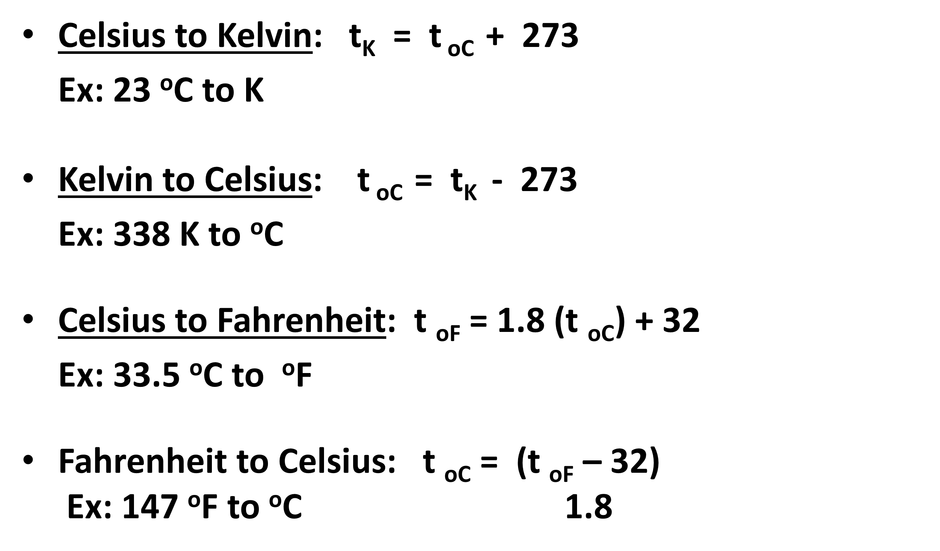
020-2021

Slide 8
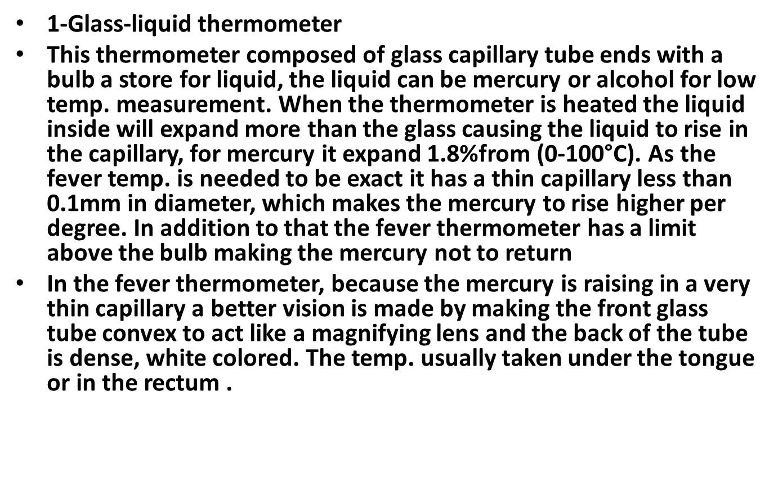
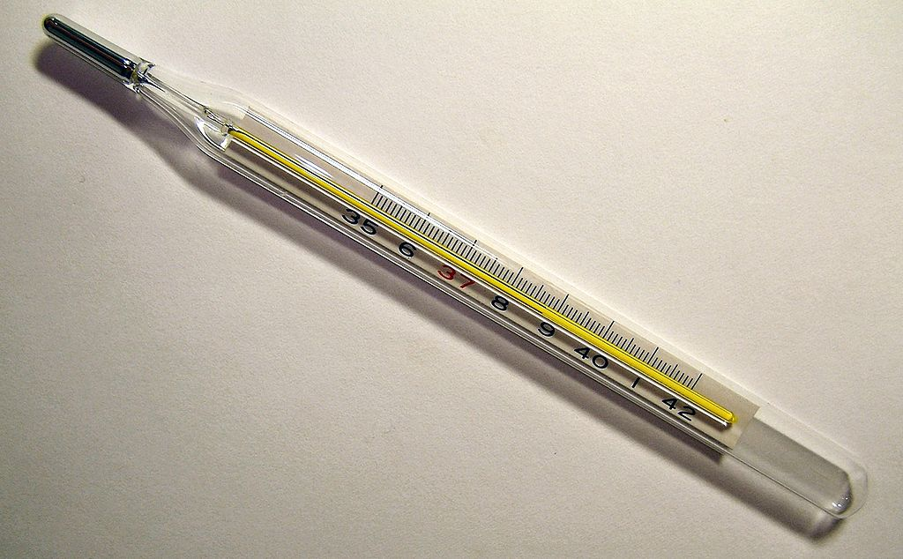
Department of:
HERE
Types of thermometers

Slide 9
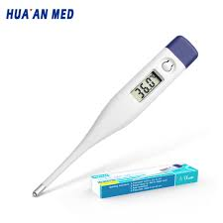
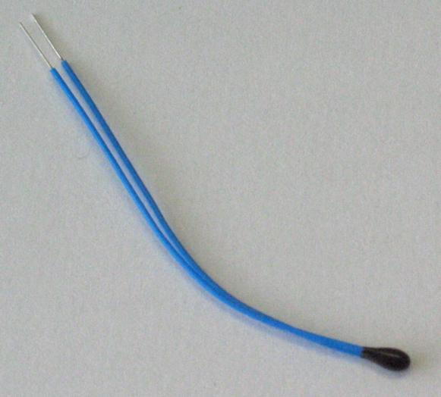
2- Thermistor
It's composed from a bridge of four resistances with a source of electricity. These resistors are in balance and one of them is used for temp. measurement (resistor T). A bridge circuit with a thermistor in one of the legs, initially the four resistors are equal, the bridge is balanced, by symmetry, the voltages at each end of the meter are equal and no current flows through the meter. A temp. change causes the thermistor resistance to change This unbalance the bridge, the voltages at each end of the meter become un equal, causing a current to flow through the meter, and the resulting meter deflection can be calibrated for temp., with thermistors it is easy to measure temp

Slide 10
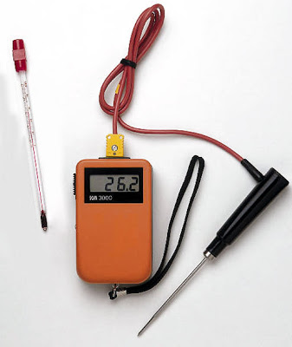
3-Thermocouple
Consist of two junctions of two different metals. If the two junctions are at different temp. , a voltage is produced that depends on the temp. difference. Usually one of the junctions is kept at a reference temp. such as in an ice-water bath. The copper-constantan thermocouple can be used to temp. from -190 to 300°C. For 100°C temp. difference, the voltage produced is only about 0.004V. Thermocouple can be made small enough to measure the temp of individual cells.

Slide 11
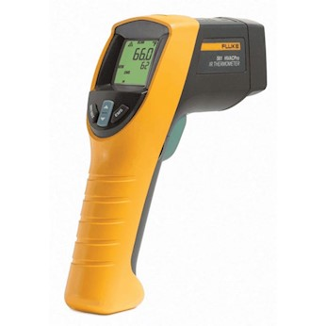
4- Infrared (IR) thermometers measure reflected infrared light, which just like any light ray is Electromagnetic Radiation, with lower frequency (or longer wavelength) than visible light and can be correlated to a specific surface temperature of the product being measured. Anything above absolute zero (-273.15 degrees Celsius or 0 degrees Kelvin) radiates in the infrared. Even ice cubes, snow, and your refrigerator emit infrared.
IR sensors collect the low amounts of energy (usually 0.0001 watt) from the target, which is then amplified by a precision amp, and convert into a voltage output. The CPU then converts this to a digital temperature reading ; you get the temperature of the target within seconds after you push that switch.

Slide 12
Specific Heat Capacity
Heat Capacity :The amount of energy that must be added to an object to raise its temperature by one degree is known as the heat capacity (Hcap) of that object. The thermal energy required to change the temperature of an object by several degrees , if thermal energy is measured in calories and temperature in degrees Celsius, then heat capacity is given in calories/degree C or in joules/degree C.
Change in thermal energy = (Heat capacity) x (Change in Temperature)
Q = Hcap x ∆T
where
Q = heat added or subtracted (calories or joules)
Hcap = heat capacity (calories/ ⁰C or joules/ ⁰C)
∆ T = change in temperature = Tfinal – Tinitial (Celsius degrees)
(Example 1)
What is the heat capacity of 100 grams of iron if 9,000 joules of thermal energy are
required to increase the temperature of the iron by 20 ⁰C?
Q = Hcap x ∆T
= 9000J/20 ⁰C =450J/⁰C

Slide 13
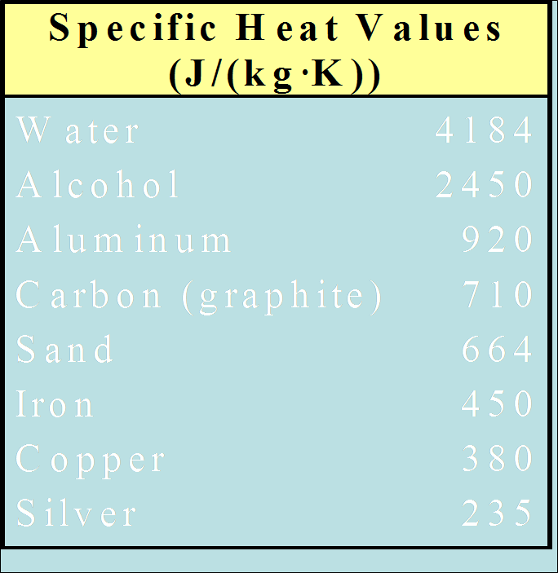
Specific heat is another physical property of matter.
If we divide the heat capacity of an object by its mass, we obtain a quantity known as the specific heat (s heat) of the object. The specific heat does not depend on the size or shape of an object, but only on the material from which it is made. Water has a large specific heat of 1 calorie per gram per degree Celsius or 4,186 joules per kilogram degree Celsius. Ice floats because the volume of water increases when it freezes. This is connected to the change in the specific heat of water near 0 ⁰C.The heat required to change the temperature of an object can be expressed as
Change in thermal energy = (Specific heat) x (Mass) x (Change in Temperature)
Q = s heat x M x ∆T
Q = heat added or subtracted (calories or joules)
s heat = specific heat (calories/gram ⁰C or joules/gram ⁰C)
M = mass (grams)
∆T = change in temperature = Tfinal – Tinitial (Celsius degrees)
If thermal energy is given in calories, mass in grams and temperature in degrees Celsius,
then specific heat is given in calories/(gram degree Celsius).
Department of:
HERE

Slide 14
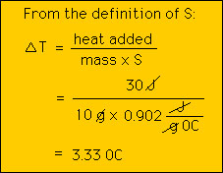
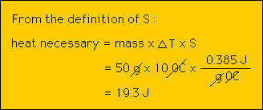
Example 2: If we add 30 J of heat to 10 g of aluminum, by how much will its temperature increase?
Example 3: How much energy does it
take to raise the temperature of 50 g of copper by 10 0C?
020-2021

Slide 15
The human body is composed of water, proteins, fat, and minerals. Its
speciﬁc heat reﬂects this composition. With 75% water and 25%
protein, the speciﬁc heat of the body would be
Speciﬁc heat=0.75×1+0.25×0.4=0.83
The speciﬁc heat of the average human body is closer to 0.83 due to
its fat and mineral content, which we have not included in the calculation.
Speciﬁc Heat for Some Substances Substance Speciﬁc Water 1 Ice 0.4Speciﬁc Heat for Some Substances
Substance Speciﬁc heat(cal/g◦C)
Water 1
Ice 0.480
Average for human body 0.83
Soil 0.2 to 0.8, depending on water content
Aluminum 0.214
Protein 0.4
Department of:
HERE

Slide 16
Latent Heat
Department of:
HERE
The amount of heat transfer required to cause a phase change in unit mass of a substance at constant volume and temperature is called as latent heat. There are three types of latent heat as there are three phases solid, liquid, gas or vapour.
The amount of heat transfer required to melt unit mass into liquid or liquid into solid is the latent heat of fusion (lfu). Latent heat of fusion Lf=80 cal/gm for water.
The latent heat of vaporization (lvap) is the amount of heat transfer required to vaporise unit mass of liquid into vapour . Latent heat of vaporization Lv=540cal/gm
The latent heat of sublimation (lsub) is the amount of heat transfer required to convert unit mass of solid into vapour

Slide 17
Heat
is the transfer of
Thermal energy
by
Conduction
Convection
Radiation

Slide 18
Conduction
Conduction is the transfer of energy as heat from one substance to another through direct contact.
As long as two objects are in contact, conduction continues until the temperatures of the objects are equal.
A conductor is a material that transfers heat very well.
Metals are typically good conductors.
An insulator is a material that is a poor conductor of heat.
Wood, paper, and plastic foam are examples of good insulators.

Slide 19
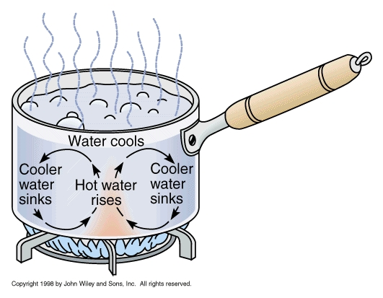
Convection
Convection is the transfer of energy as heat by the movement of a liquid or gas.
Convection occurs when a cooler, denser mass of gas or liquid replaces a warmer, less dense mass of gas or liquid by pushing it upward
When water is boiled, the water moves in roughly circular patterns because of convection.
This motion is due to density differences
that result from temperature differences.
The motion is called a convection current.

Slide 20
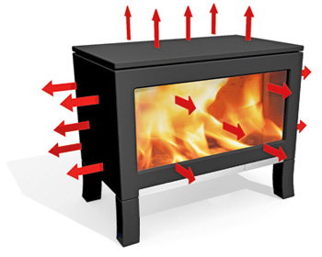
Radiation
Radiation is the transfer of energy by electromagnetic waves.
Examples of EM waves: visible light, microwaves, infrared light
When radiation is emitted from one object and then absorbed by another, the result is the transfer of heat.
Radiation can travel through empty space.

