Slide 1
Exploring the start menu
Start Menu
The Start menu is the main gateway to your computer's programs, folders, and settings. It's called a menu because it provides a list of choices, just as a restaurant menu does.

Slide 2
To display the Start Menu do the following:
Move the mouse pointer to start button on the taskbar
Click the start button once.
You can choose from a menu by moving the mouse pointer over an item.

Slide 3
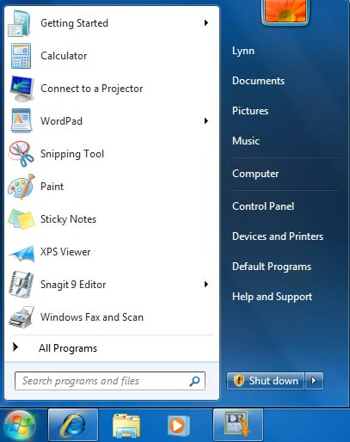
The Start Menu
System folders
Programs
Control Panel
Help and Support
All Programs
Search box
Shut down
Start button

Slide 4
How you can do these
application in windows?

Slide 5
View the content of a folder
Viewing and arranging files and folders.
Each time you click the Views button, the folder window changes the way it displays your file and folder icons, alternating between large icons, a smaller icon view called Tiles, and a view called Details that shows several columns of information about the file.

Slide 6
Change Icon size
1- Right Click the
desktop
2- Click View
3- Show the required
size

Slide 7
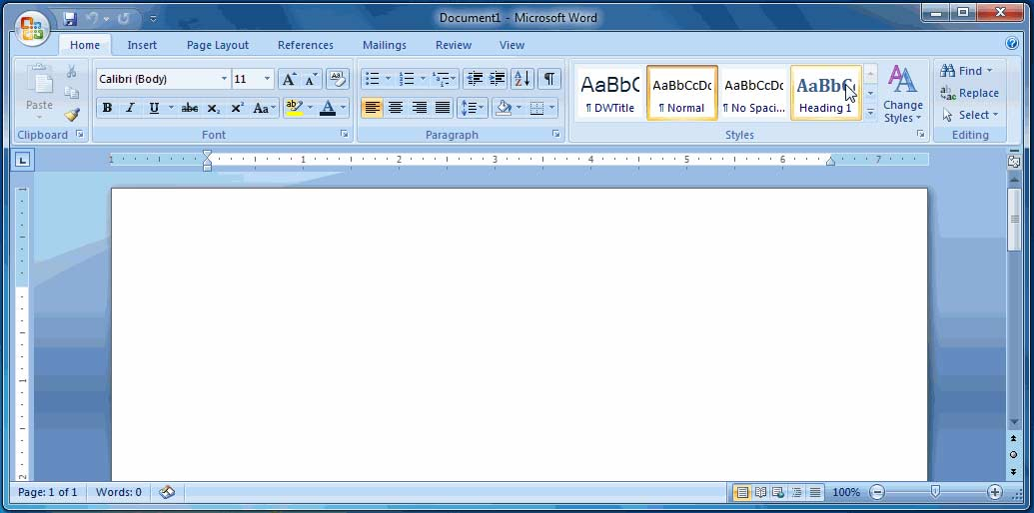
Window Components
Maximize window
Title bar
Minimize window
Close window
Scroll bar

Slide 8
Windows 7 can arrange windows for you in three different configurations. Windows can be displayed in a cascading fashion, vertically stacked, or side by side. To set this up, right-click on an empty portion of the taskbar and click the configuration you want to use. Shown here is the cascading display of three open windows. Note that you can see each title bar.

Slide 9
arrange the windows in a cascading fashion
Right-click on an empty portion of the taskbar the
Configuration you want to use 1.cascading
2.vertically
3.side to side
you can cycle through all Open windows.

Slide 10
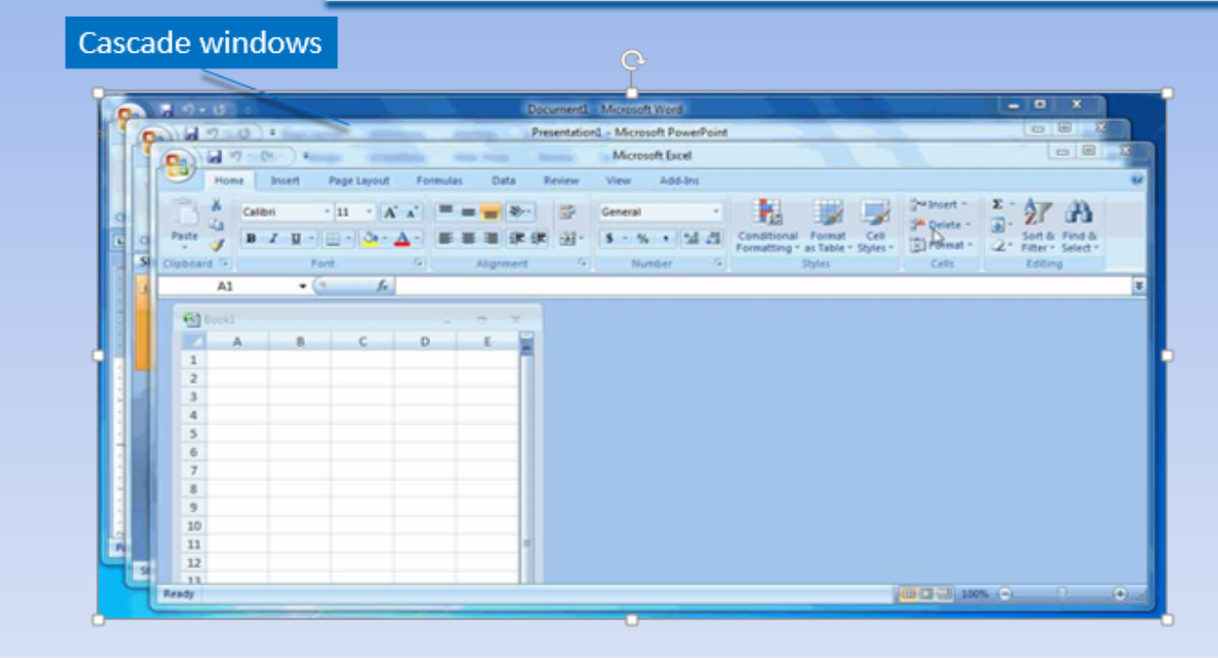
Window Components (continued)

Slide 11
Another handy Windows 7 tool is Snap. This feature automatically places a window on the side of the desktop. Click and drag the title bar of a window to the left or right side of the desktop until an outline of a window appears. Release the mouse button and the window will snap into place.

Slide 12
Places automatically window on the side of the disk top (use snap tool in window7)
Click and drag the tittle bar of the window to the left or right
Side of the disk top until an outline of a window appear.

Slide 13
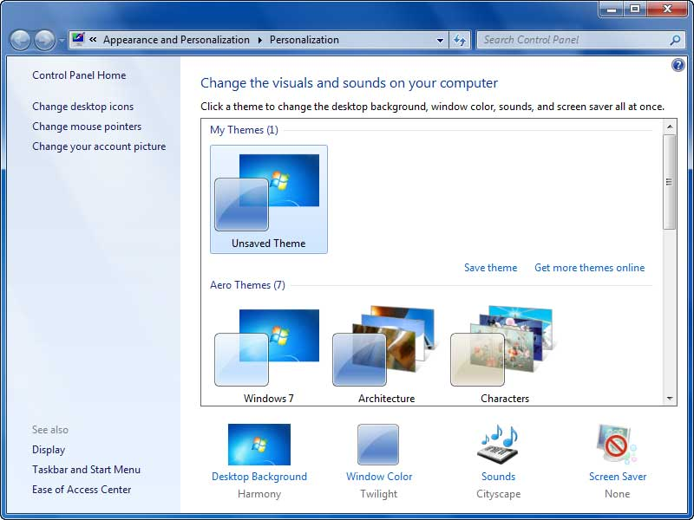
Customize the Desktop
Themes
Desktop Background
Window Color
Screen Saver

Slide 14
Just as you can rearrange the items on your desk, you can customize your desktop to make it uniquely suited to your tastes. The screen saver, a series of moving pictures that appears when your computer has been idle for a period of time, along with background and window color, are selected from the Personalization window. Right-click on an empty portion of the desktop and select Personalize to open this window.

Slide 15
The Desktop Backgrounds include built-in categories or you may select a personal picture from a folder on your computer. Many people enjoy placing family photos or pet photos on the background of their desktop. Likewise the screen saver, which provides privacy for your open files on the computer when you are away from your desk, is changed with built-in screen savers.

Slide 16
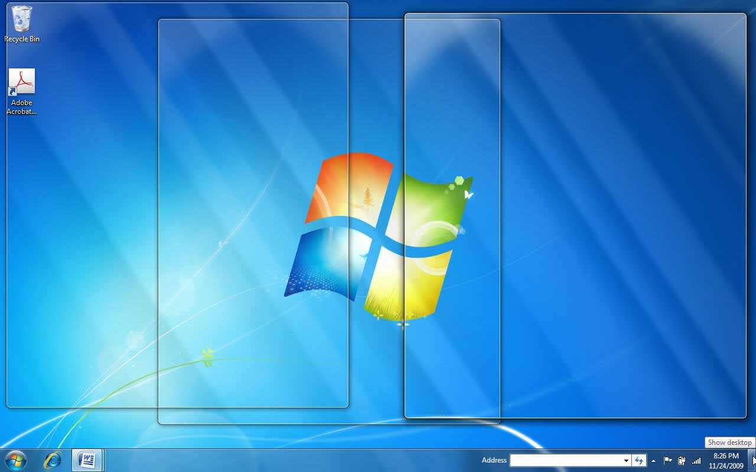
Showing the Desktop
Three documents (transparent) in Aero Peek
Show desktop button

Slide 17
No matter how many open windows you have, click the Show desktop button in the lower right corner of the desktop. Your programs and windows will still be available, but you will have a clean desktop. This feature can ensure privacy because you can quickly return to the desktop view before you step away from your desk or if someone comes into your office.

Slide 18
If you want to see something on your desktop, such as a gadget clock or calendar, but not minimize the open windows, just point to the Show desktop button. Your desktop will be displayed until you move the mouse pointer away from the button. This slide shows three Word documents that are transparent while the mouse pointer is over the Show desktop button. This is an additional Aero Peek feature.

Slide 19
Windows Accessories

Slide 20
Windows 7 contains accessory application software that enables you to accomplish a few basic tasks. The programs include Notepad, WordPad, Paint, Snipping Tool, and Calculator.
Notepad is a text editing application. It focuses mainly on capturing text. Computer programmers and Web designers often use it to write programs. Document formatting is not a feature of Notepad. You can see that the window is very plain.

Slide 21
WordPad, in contrast, is more like a word processing program. It includes a more robust interface, enabling you to format text and insert graphics. It is a handy application if you do not have access to Microsoft Word. WordPad saves the documents in Microsoft Word format so that they can open in Word. Granted, it does not contain all of the functions of Microsoft Word, but it does have the basic tools.

Slide 22
Access Note pad or Word pad ,Paint
start button all programs accessories select either Note pad or Word pad.
Save your work of arts on Paint
Click save button at top of the window. To save the painting.

Slide 23
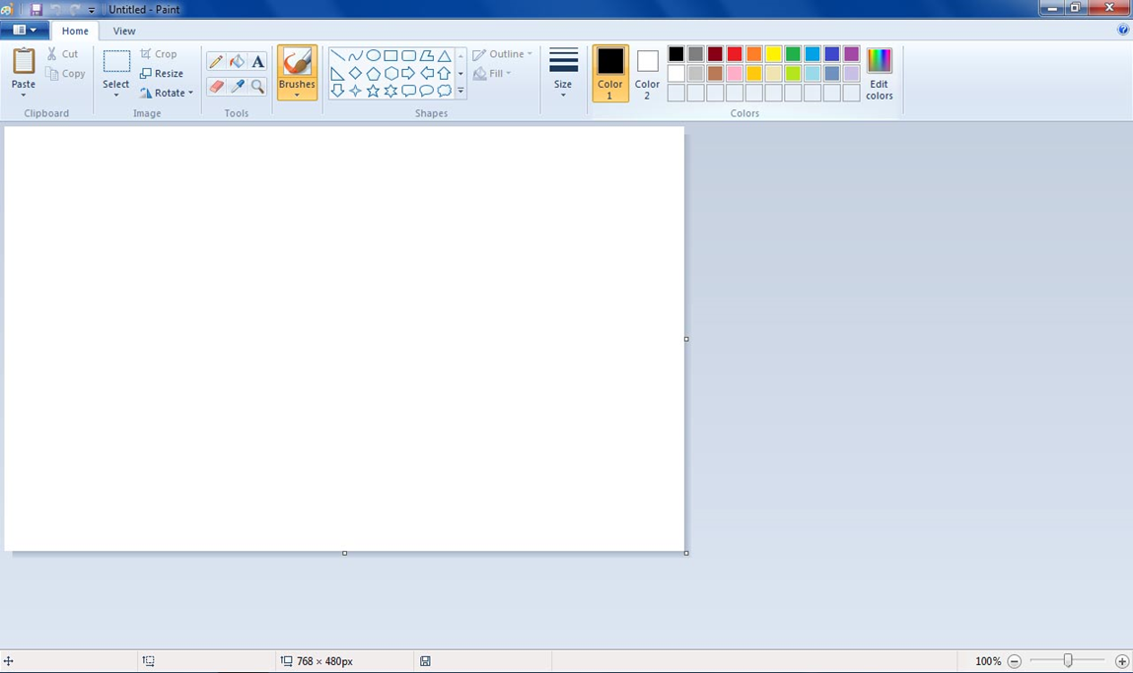
Windows Accessories
(continued)
Click here to open a picture
Ribbon

Slide 24
A graphics accessory, Paint, enables you to create drawings and to open digital photographs or graphics. Click the Start button, All Programs, Accessories, and Paint to open the application.

Slide 25
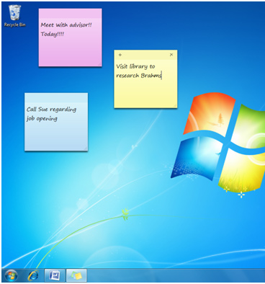
Windows Accessories
(continued)
Sticky notes

Slide 26
With Windows 7, the sticky notes are available to place right on your desktop! Open Sticky Notes by clicking the Start button, All Programs, Accessories, and Sticky Notes. Record your to-do list, phone numbers, and meeting reminders by typing on the note.

Slide 27
Notice that the font even looks like handwriting. Click the plus sign in the upper left corner of the Sticky Note to open a new note. To change the color of a note, right click on the body of the note and select a different color. To delete a note, click the Delete Note button in the upper right corner of the note. You might like to place your Sticky Note pad on your desktop by pinning the Sticky Notes to your taskbar.

Slide 28
Place sticky notes on your desk top
start button all programs accessories sticky notes.
To add or open anew note click(+ sign) in upper left corner of the sticky .
To delete a note click the delete note button in the upper right corner of the note.
To change the color of the note right click on the body of the note and select the color.

Slide 29
Adding Gadgets
Gadgets, such as a clock, calendar, photo slide show, headline feed, or puzzle, are added to your desktop to make it more convenient for you to use

Slide 30
Gadgets, such as a clock, calendar, photo slide show, headline feed, or puzzle, are added to your desktop to make it more convenient for you to use. Gadgets run constantly on your desktop. Gadgets can be selected from Windows 7 or downloaded from the Internet.
To install a Gadget on your desktop, right-click on an empty portion of your desktop and click Gadgets. Double-click or drag a gadget to place it on your desktop. To remove a gadget from your desktop, right-click the gadget and click Close gadget.

Slide 31
Personalize the window
By right-click on an empty potion of the desktop
select personalize to open this window.
minimize the window
Press the control button on the right side of tittle bar.
maximize the window
Press the control button on the right side of tittle bar.

Slide 32
close the window
Press the control button on the right side of tittle bar.
Minimize window
Maximize window
Close window

Slide 33
View the contents of the Recycle Bin
Recycle Bin icon:-
contains files and folders that you delete. The deleted files are not gone until you empty the Recycle bin.
Double click the Recycle bin to view the contents.

Slide 34
Open an object’s shortcut menu.
Right-click an object opens it’s shortcut menu.
Active a window that is covered by other windows using the task bar.
By clicking the program icon.

Slide 35
View an application icon for each open window
Right-click an open area of taskbar select properties click never combine on the taskbar buttons list box ok.
Add toolbars to the taskbar
Right-click on an area of the taskbar point to toolbar
and select the toolbars you wish to use a check mark appears next to
Toolbars that active on taskbar.

Slide 36
Open the jump list , when applications are open on desktop.
Right-click the program icon on the taskbar to open
The jump list.
Remove pinned applications from the taskbar
Right-click of the program icon And selecting
unpin this program from the taskbar.

Slide 37
Open Notification
By clicking on the open action center link.
Show the pop_up window to display information
By clicking action center icon on the taskbar displays the information.

Slide 38
How many security settings and software windows7 providing you write the names of it :-
6 software.
Action center.
windows update.
windows firewall.
windows defender.
user account control.
parental controls.

Slide 39
Any Questions

