Slide 1
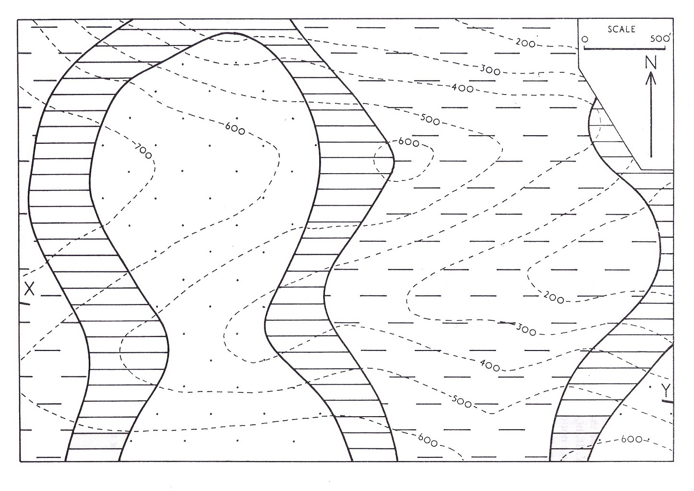
400B/C
300B/C
500B/C
300B/C
400B/C
Axis of Syncline
400A/B 600B/C
Axis Of Anticline
500A/B 700B/C
300A/B 500B/C
400A/B 600B/C
300A/B 500B/C
200A/B 400B/C
700A/B
500A/B
400A/B 600B/C
600A/B
600A/B
500A/B
600A/B
A
B C B A B C

Slide 2
Geologic Cross Section
Thickness m.
Vertical
True
Young bed
Dip Amount 32°
C
B
200
170
Old bed
A
Axis of Anticline
Axis of Syncline
800
600
Elevation m.
400
B
C
C
200
A
A
B
X
Y

