Slide 1
Tools
Dr. Ahmed Suhail

Slide 2
Outline for the lectures
Introduction
Approaches used
Materials
Techniques & Tools
Applications

Slide 3
Tools
Optical Microscope
Raman Microscope
Atomic Force Microscope
X-Ray photoelectron spectroscopy

Slide 4
Optical Microscope
An optical microscope is shown in Fig, and it is used to analyse the uniformity and continuity of CVD-graphene layers transferred onto SiO₂/Si substrates.
Figure : Optical Microscope

Slide 5
Principle of its working
(a) Schematic of reflected and transmitted light from graphene/SiO2/Si substrate. (b) Optical image of CVD-graphene transferred onto a SiO2/Si substrate.

Slide 6
Principle of its working
The intensity of the white light source can be controlled. Fig. a shows how the light source interacts with the three interfaces at graphene, SiO₂ and Si layers. Since a part of the incident light is reflected from each interface and the rest of that light is transmitted and refracted. Therefore, a number of optical paths are possible. The amplitude of the reflected light, which makes the visibility of graphene layers on SiO₂/Si substrates, is as a result of interference between all the optical paths.

Slide 7
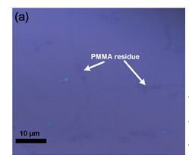
Application of it
The PMMA residue left on graphene surface can be checked by using optical microscope. The residue will be as dark spots onto graphene as shown in Fig. below.

Slide 8
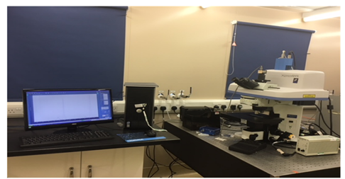
Raman Microscope
Raman spectroscopy is a unique tool to analyse the crystallinity, doping and impurity content of graphene sheets through positions and ratios of graphene peaks.
Figure : Raman Microscope

Slide 9
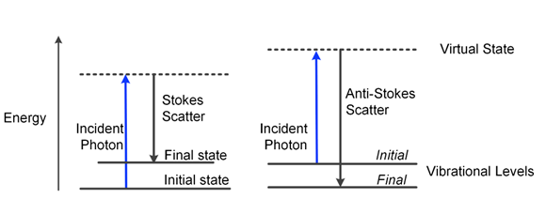
Principle of its working
(a) Schematic of Raman scattering process, showing Stokes and Anti -Stokes Scatters.

Slide 10
Principle of its working
Raman spectroscopy is based on the inelastic scattering of monochromatic light as shown in previous figure. Inelastic scattering means that the frequency of the photon will change when it interacts with the molecules in graphene crystal. When molecules absorb an incident photon with frequency at the ground state, it will excite into a virtual state. There are two types of the scattering processes. If the excited molecule decays back to a higher level than the initial, this is called Stokes Scattering. Anti -Stokes Scattering is obtained if the exciting molecule decays back to a lower level than initial. According to the changes of the wavelengths or wave numbers of scattered light, which is caused by the molecular rotation and vibration, information about molecular structure and defect density is obtained.

Slide 11
Application of it
The PMMA residue left on graphene surface can be checked by using Raman microscope. The residue will shift the spectrum to the higher Raman shift (cm ⁻¹) as shown in Fig.
Black line with more residue, whereas
the blue line has less residue

Slide 12
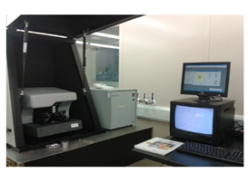
Atomic force Microscopy (AFM)
AFM is a tool used to investigate the topographic of graphene surface.
Figure : AFM

Slide 13
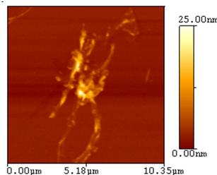
Application of it
The PMMA residue left on graphene surface can be checked by using AFM. The residue will be as spots as shown in Fig.
AFM image of the transferred monolayer graphene.

Slide 14
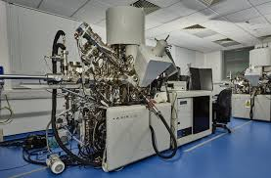
X-Ray photoelectron spectroscopy
PMMA residue left on a CVD-graphene surface is investigated by XPS since this technique is one of the best techniques to study the elemental composition and chemical state of the graphene surface.
Figure : XPS

Slide 15
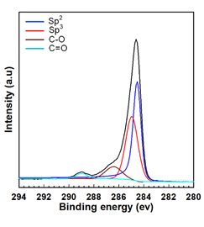
Application of it
The PMMA residue left on graphene surface can be checked by using AFM. The residue will be represented by peaks in the spectra as shown in Fig.
Black spectrum is for overall for all spectra, blue line is for graphene, others are for PMMA residue

