Slide 1



Heat Transfer UNIT 1
University of Mosul
Collage of Science
Department of New and Renewable Energies
By:
Dr. Ghada Ghanim Younis
Ms. Zainab Abdulazeez Jameel

Slide 2

Google Classroom
Classroom Code: kcxscm2j

Slide 3
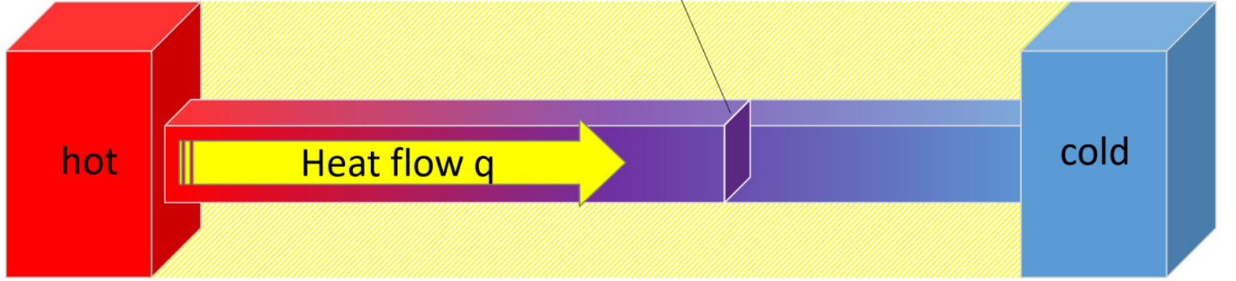
1.1. Introduction
Heat is the form of energy that can be transferred from one system to another as a result of temperature difference.
A thermodynamic analysis is concerned with the amount of heat transfer as a system undergoes a process from one equilibrium state to another.
The science that deals with the determination of the rates of such energy transfers is the heat transfer.
The transfer of energy as heat is always from the higher-temperature medium to the lower-temperature one, and heat transfer stops when the two mediums reach the same temperature.
1

Slide 4
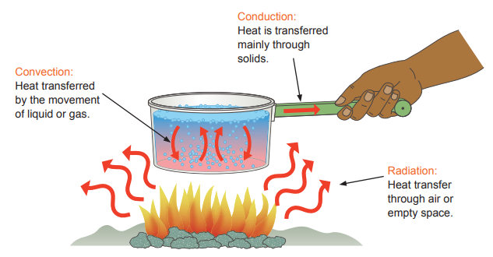
Heat can be transferred in three different modes: conduction, convection, and radiation.
All modes of heat transfer require the existence of a temperature difference and all modes are from the high-temperature medium to a lower-temperature one.
2

Slide 5
1.2. Forms of Energy
Forms of energy include:
Kinetic energy – energy arising from motion. This is important if the system is rapidly moving, such as a car. Most processes are fairly stationary, so the kinetic energies involved are negligible and can be ignored in the energy balance. But this might not be true if, for example, a stream enters or leaves the system with high velocity, such as a jet from a nozzle.
Potential energy – energy arising from being moved against gravity. Most processes occur at or near the earth's surface, so potential energy is not a major consideration in an energy balance. However, when liquids are pumped to reasonable heights above the ground, the energy requirement to pump them may be substantial, and certainly is the energy that you would need to consider in sizing the pump motor.
3

Slide 6
Forms of Energy
Internal energy – the energy of molecular motion (translation, vibration and rotation) and of intermolecular attraction and repulsion This is related to enthalpy, which we will talk about later, and is usually obtained from tables.
Heat and Work – In many ways these are the forms of energy most familiar to us. In an important sense, heat and work are different from the other forms of energy described above, in that they are energy in transit, i.e. energy being transferred from one body to another. Possibly this is why they seem familiar to us. Looking at a brick, it is not evident that it contains internal energy, but if you drop it on your foot, the work it does on your foot is felt quite evidently.
4

Slide 7
1.2.1. Heat
Heat is the most familiar form of energy. We know that a stove feels hot and ice feels cold.
To describe this familiar phenomenon more carefully, what happens is that when we touch a stove, heat flows from the stove to our hand, and it therefore feels hot (relative to our hand).
When we touch an ice cube, heat flows from our hand to the ice cube, and it feels cold (relative to our hand).
5

Slide 8
1.2.1. Heat
From these familiar notions we can formulate two important ideas:
Heat is a form of energy which flows, or as we often say, is transferred from one object to another or between a system and its surroundings. Because of this heat flow, one object loses some energy, and the other object gains this energy. When we hold an ice cube, heat flows from our hand to the ice cube. So our hand loses some of its energy content, as shown by the decrease in its temperature. Conversely, the energy content of the ice cube increases, as shown by the fact that the ice cube melts. So heat is a form of energy in transit, a form which flows or is transferred as a result of a temperature difference.
Secondly, in order for there to be a flow of heat, there must be a temperature difference or gradient (heat, like water, will only flow “downhill”).
6

Slide 9
1.2.1. Heat
From these two ideas, we can define heat as “the form of energy which flows from one object or system to another as the result of a temperature difference”. And it is one of the laws of thermodynamics, and something that we know from our very day experience, that the direction of the flow is from hotter bodies to colder bodies.
7

Slide 10
Units of Heat
Early in the development of thermodynamics, before scientists realized the connection between thermodynamics and mechanics, heat was defined in terms of the temperature changes it produced in an object, and a separate unit of energy, the calorie, was used for heat.
The calorie (cal) is defined as the energy necessary to raise the temperature of 1 g of water from 14.5°C to 15.5°C. (The “Calorie,” with a capital “C,” used in describing the energy content of foods, is actually a kilocalorie.)
Likewise, the unit of heat in the U.S. customary system, the British thermal unit (Btu), was defined as the energy required to raise the temperature of 1 lb of water from 63°F to 64°F.
In 1948, scientists agreed that because heat (like work) is a measure of the transfer of energy, its SI unit should be the joule.
8

Slide 11
Units of Heat
The calorie is now defined to be exactly 4.186 J:
1 cal = 4.186 J
This definition makes no reference to raising the temperature of water. The calorie is a general energy unit, introduced here for historical reasons, although we will make little use of it. The definition in Equation is known, from the historical background we have discussed, as the mechanical equivalent of heat.
9

Slide 12
1.2.2. Enthalpy
We noted earlier the concept of Internal Energy, that is, the energy that a material possesses as a result of the motion and attractions and repulsions of its molecules.
This energy depends on the composition of the material and its state, which is determined by the temperature and pressure. Related to the internal energy is the Enthalpy, h.
The properties of enthalpy are as follows:
For a given material, at constant pressure, the enthalpy depends only on the material’s temperature and physical state (i.e. liquid, solid, vapour) So, for example, water at 100 ⁰C has less energy and less enthalpy than steam at 100 ⁰C.
At constant temperature and physical state, the change of enthalpy with pressure is zero for ideal gases and small for liquids and solids.
10

Slide 13
1.2.2. Enthalpy
This means that, for liquids, if you know the enthalpy at a given temperature and the corresponding vapour pressure then this is close enough for other pressures. So tables often give enthalpy data at a particular temperature and the corresponding vapour pressure.
There are no absolute values for enthalpy. Instead, the enthalpy of a substance is given a value of zero at some arbitrary datum point, and all other enthalpies are quoted relative to this reference point.
For many substances the reference datum is set at 25 ⁰C and 1 atm pressure, with the substance in its physical state normal to those conditions. But other datum points can be taken – for example, for water, the datum point at which the enthalpy of liquid water is zero is often taken to be the triple point (the point at which solid, liquid and gaseous water can coexist) which occurs at a conveniently close to zero temperature of 0.01 ⁰C, and its equilibrium vapour pressure of 611.2 Pa.
11

Slide 14
1.3. Specific Heat Capacity
Which weighs more, a kg of water or a kg of air?
Okay, then which will require more energy to heat it up?
When you heat a material up, its enthalpy increases as the temperature increases. How much energy (or enthalpy) does it take to raise the temperature of a material by, say, 1 ⁰C?
This depends on the material. For water, for example, it takes about 4180 J to raise the temperature of 1 kg by 1⁰C, while for air, it takes only about 1005 J (less than a quarter) to achieve the same temperature rise.
12

Slide 15
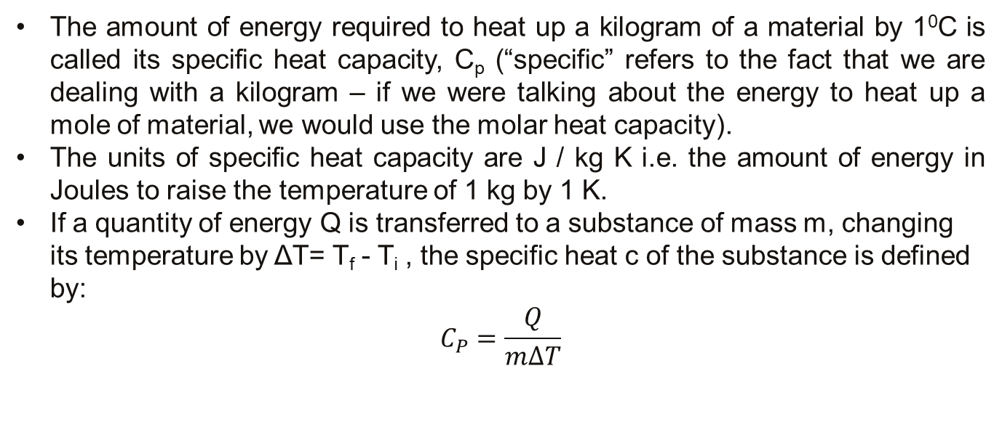
1.3. Specific Heat Capacity
The amount of energy required to heat up a kilogram of a material by 1⁰C is called its specific heat capacity, C_{p} (“specific” refers to the fact that we are dealing with a kilogram – if we were talking about the energy to heat up a mole of material, we would use the molar heat capacity).
The units of specific heat capacity are J / kg K i.e. the amount of energy in Joules to raise the temperature of 1 kg by 1 K.
If a quantity of energy Q is transferred to a substance of mass m, changing its temperature by ΔT= T_{f} - T_{i} , the specific heat c of the substance is defined by:
$$C_{P}=\frac{Q}{m∆T}$$
13

Slide 16
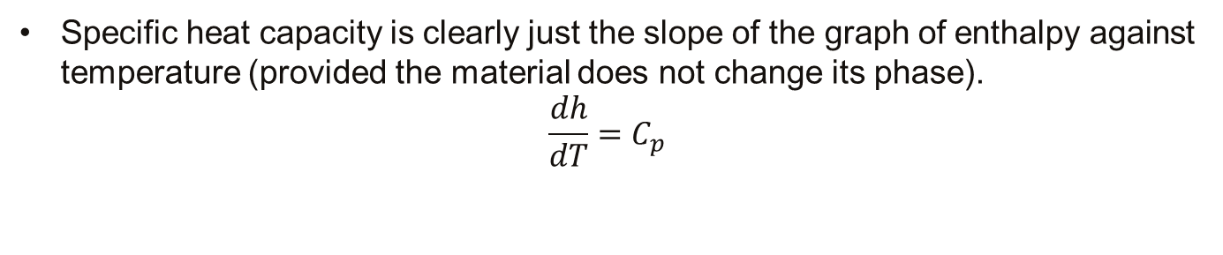
1.3. Specific Heat Capacity
Specific heat capacity is clearly just the slope of the graph of enthalpy against temperature (provided the material does not change its phase).
$$\frac{dh}{dT}=C_{p}$$
Specific heat capacity depends slightly on the temperature. When calculating the energy required to achieve a particular temperature change, use the specific heat capacity at the midpoint temperature (but not if there is a phase change involved! – in this case, the energy requirements above and below the phase change must be calculated separately). Or, for a more accurate calculation, look up the enthalpy of the material at the two temperatures, and subtract one from the other.
14

Slide 17
1.3. Specific Heat Capacity
Note that when the temperature increases, ΔT and Q are positive, corresponding to energy flowing into the system. When the temperature decreases, ΔT and Q are negative, and energy flows out of the system.
Table 1 shows that water has the highest specific heat relative to most other temperatures found in regions near large bodies of water. As the temperature of a body of water decreases during winter, the water transfers energy to the air, which carries the energy landward when prevailing winds are toward the land. The fact that the specific heat of water is higher than the specific heat of sand is responsible for the pattern of airflow at a beach. During the day, the Sun adds roughly equal amounts of energy to the beach and the water, but the lower specific heat of sand causes the beach to reach a higher temperature than the water. As a result, the air above the land reaches a higher temperature than the air above the water.
15

Slide 18
1.3. Specific Heat Capacity
The denser cold air pushes the less dense hot air upward (due to Archimedes’ principle), resulting in a breeze from ocean to land during the day.
A similar effect produces rising layers of air called thermals. A thermal is created when a portion of the Earth reaches a higher temperature than neighboring regions.
Thermals often occur in plowed fields, which are warmed by the Sun to higher temperatures than nearby fields shaded by vegetation. The cooler, denser air over the vegetation covered fields pushes the expanding air over the plowed field upward, and a thermal is formed.
16

Slide 19

Quick Quiz
Suppose you have 1 kg each of iron, glass, and water, and all three samples are at 10°C.
(a) Rank the samples from lowest to highest temperature after 100 J of energy is added to each by heat.
(b) Rank them from least to greatest amount of energy transferred by heat if enough energy is transferred so that each increases in temperature by 20°C.
17

Slide 20


