Slide 1



Heat Transfer UNIT 1
University of Mosul
Collage of Science
Department of New and Renewable Energies
By:
Dr. Ghada Ghanim Younis
Ms. Zainab Abdulazeez Jameel

Slide 2
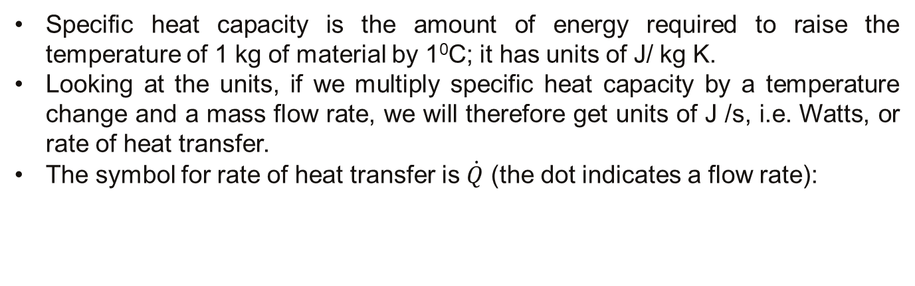
1.4. Rate of Energy Transfer
Specific heat capacity is the amount of energy required to raise the temperature of 1 kg of material by 1⁰C; it has units of J/ kg K.
Looking at the units, if we multiply specific heat capacity by a temperature change and a mass flow rate, we will therefore get units of J /s, i.e. Watts, or rate of heat transfer.
The symbol for rate of heat transfer is $\dot{Q}$ (the dot indicates a flow rate):
18

Slide 3
1.5. Latent heat of vaporisation/condensation (hfg) and latent heat of fusion/melting (hsf )
A substance usually undergoes a change in temperature when energy is transferred between the substance and its environment.
In some cases, however, the transfer of energy doesn’t result in a change in temperature.
This can occur when the physical characteristics of the substance change from one form to another, commonly referred to as a phase change.
Some common phase changes are solid to liquid (melting), liquid to gas (boiling), and a change in the crystalline structure of a solid.
Any such phase change involves a change in the internal energy, but no change in the temperature.
19

Slide 4
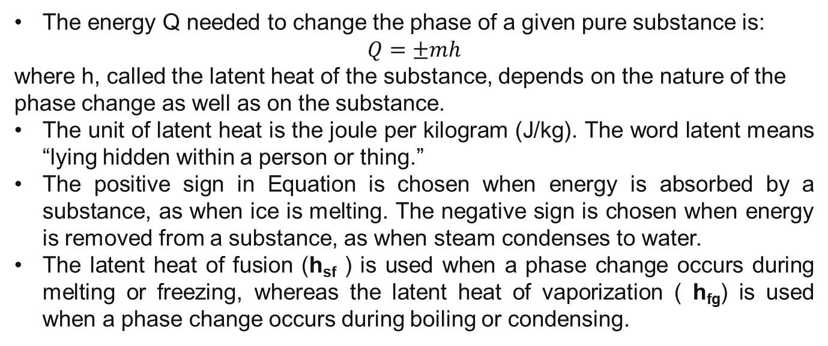
1.5. Latent heat of vaporisation/condensation (hfg) and latent heat of fusion/melting (hsf )
The energy Q needed to change the phase of a given pure substance is:
$$Q=±mh$$
where h, called the latent heat of the substance, depends on the nature of the phase change as well as on the substance.
The unit of latent heat is the joule per kilogram (J/kg). The word latent means “lying hidden within a person or thing.”
The positive sign in Equation is chosen when energy is absorbed by a substance, as when ice is melting. The negative sign is chosen when energy is removed from a substance, as when steam condenses to water.
The latent heat of fusion (h_{sf} ) is used when a phase change occurs during melting or freezing, whereas the latent heat of vaporization ( h_{fg}) is used when a phase change occurs during boiling or condensing.
20

Slide 5
1.5. Latent heat of vaporisation/condensation (hfg) and latent heat of fusion/melting (hsf )
For example, at atmospheric pressure the latent heat of fusion for water is 3.33×10⁵ J/kg and the latent heat of vaporization for water is 2.26×10⁶ J/kg.
The latent heats of different substances vary considerably, as can be seen in Table 2.
Another process, sublimation, is the passage from the solid to the gaseous phase without going through a liquid phase.
The fuming of dry ice (frozen carbon dioxide) illustrates this process, which has its own latent heat associated with it, the heat of sublimation.
21

Slide 6
1.5. Latent heat of vaporisation/condensation (hfg) and latent heat of fusion/melting (hsf )
22

Slide 7
1.5. Latent heat of vaporisation/condensation (hfg) and latent heat of fusion/melting (hsf )
To better understand the physics of phase changes, consider the addition of energy to a (1 g) cube of ice at (-30) °C in a container held at constant pressure. Suppose this input of energy turns the ice to steam (water vapor) at (120) °C.
23

Slide 8
1.5. Latent heat of vaporisation/condensation (hfg) and latent heat of fusion/melting (hsf )
Part A During this portion of the curve, the temperature of the ice changes from -30.0°C to 0.0°C. Because the specific heat of ice is 2 090 J/kg °C, we can calculate the amount of energy added is:
Q = m C_{ice} ΔT = (1.0 × 10 ⁻³ kg) (2 090 J/kg °C)(30.0°C) = 62.7 J
Part B When the ice reaches 0°C, the ice–water mixture remains at that temperature— even though energy is being added—until all the ice melts to become water at 0°C, the energy required to melt 1.00 g of ice at 0°C is:
Q = m h_{sf} = (1.0 × 10 ⁻³ kg) (3.33 × 10⁵ J/kg) = 333 J
Part C Between 0°C and 100°C, no phase change occurs. The energy added to the water is used to increase its temperature, as in part A. The amount of energy necessary to increase the temperature from 0°C to 100°C is:
Q = m C _{water} ΔT = (1.0 × 10 ⁻³ kg) (4.19 × 10³ J/kg °C) (100°C)
Q = 4.19 × 10² J
24

Slide 9
Latent heat of vaporisation/condensation (hfg) and latent heat of fusion/melting (hsf )
Part D at 100°C, another phase change occurs as the water changes to steam at 100°C. As in Part B, the water–steam mixture remains at constant temperature, this time at 100°C—even though energy is being added—until all the liquid has been converted to steam. The energy required to convert 1.00 g of water at 100°C to steam at 100°C is:
Q = m h_{fg} = (1.0 × 10 ⁻³ kg) (2.26 ×10⁶ J/kg) = 2.26 × 10³ J
Part E During this portion of the curve, as in parts A and C, no phase change occurs, so all the added energy goes into increasing the temperature of the steam. The energy that must be added to raise the temperature of the steam to 120.0°C is:
Q = m C _{steam} ΔT = (1.0 × 10 ⁻³ kg) (2.01×10³ J/kg °C) (20.0°C) = 40.2 J
25

Slide 10
1.5. Latent heat of vaporisation/condensation (hfg) and latent heat of fusion/melting (hsf )
The total amount of energy that must be added to change 1.0 g of ice at -30.0°C to steam at 120.0°C is the sum of the results from all five parts of the curve, 3.1×10³ J. Conversely, to cool 1.0 g of steam at 120.0°C to the point at which it becomes ice cooled to -30.0°C, 3.1×10³ J of energy must be removed.
Phase changes can be described in terms of rearrangements of molecules when energy is added to or removed from a substance. Consider first the liquid-to-gas phase change.
The molecules in a liquid are close together, and the forces between them are stronger than the forces between the more widely separated molecules of a gas.
Work must therefore be done on the liquid against these attractive molecular forces so as to separate the molecules.
26

Slide 11
1.5. Latent heat of vaporisation/condensation (hfg) and latent heat of fusion/melting (hsf )
The latent heat of vaporization is the amount of energy that must be added to the one kilogram of liquid to accomplish this separation.
Similarly, at the melting point of a solid, the amplitude of vibration of the atoms about their equilibrium positions becomes great enough to allow the atoms to pass the barriers of adjacent atoms and move to their new positions.
On average, these new positions are less symmetrical than the old ones and therefore have higher energy. The latent heat of fusion is equal to the work required at the molecular level to transform the mass from the ordered solid phase to the disordered liquid phase.
27

Slide 12
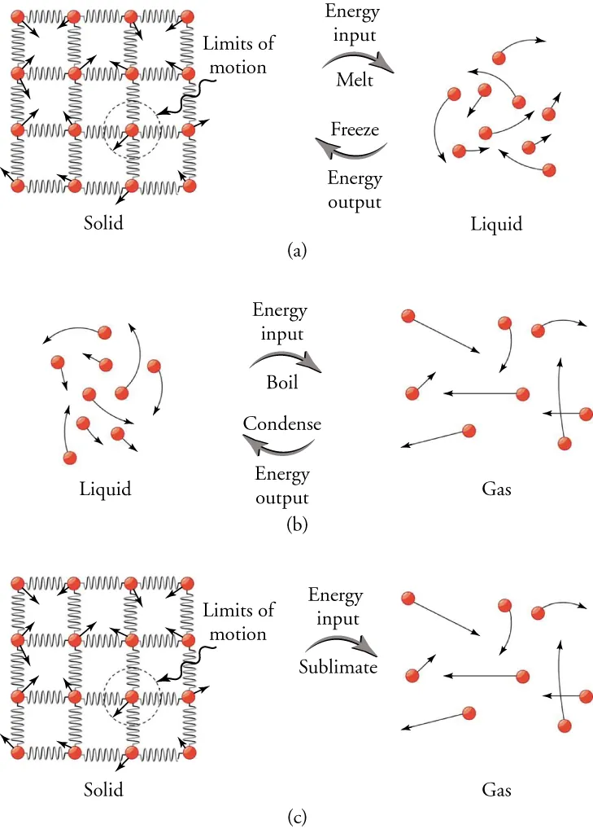
1.5. Latent heat of vaporisation/condensation (hfg) and latent heat of fusion/melting (hsf )
The average distance between atoms is much greater in the gas phase than in either the liquid or the solid phase. Each atom or molecule is removed from its neighbors, overcoming the attractive forces of nearby neighbors.
Therefore, more work is required at the molecular level to vaporize a given mass of a substance than to melt it, so in general, the latent heat of vaporization is much greater than the latent heat of fusion (see Table 2).
28

Slide 13
1.6. Thermophysical Properties of Water, Steam, and Air
The most commonly encountered materials in the process industries are water, steam and air, and if you know how to read enthalpy tables for these, you will be able to do it for other substances.
Table 3 shows typical values of important thermophysical properties for water, steam and air. Note that values are given for different temperatures, either 0, 25, or 100 ⁰C.
29

Slide 14
1.6. Thermophysical Properties of Water, Steam, and Air
Table 3: Typical values of important thermophysical properties of water, ice, steam, and air.
30

Slide 15
1.6. Thermophysical Properties of Water, Steam, and Air
Example: What is the energy requirement to raise the temperature of 60 kg of water from 10 ⁰C to 80 ⁰C? Calculate the answer in two ways – by using the specific heat capacity at the midpoint temperature (45 ⁰C), and by subtracting the enthalpy of water at 10 ⁰C from the enthalpy of water at 80 ⁰C. Why are the two answers different? Which answer is more accurate?
Example: What is the energy requirement to convert 1 kg of water at 10 ⁰C into steam at 150 ⁰C? Calculate your answer by adding the energy required to raise the water from 10 ⁰C to 100 ⁰C (using the specific heat capacity at the midpoint temperature of 55 ⁰C), adding the latent heat of vaporisation, the adding the energy to raise the steam from 100 ⁰C to 150 ⁰C (again using the appropriate mid-point temperature to look up the specific heat capacity). Then calculate the energy requirement by subtracting the enthalpy of water at 10 ⁰C from the enthalpy of steam at 150 ⁰C. How do the two answers compare?
31

Slide 16
1.7. Conservation of energy and energy balances
Energy is expensive. An energy balance accounts for all the energy entering and leaving a system. If we overlook one of the forms of energy entering or leaving the system, we will not calculate the energy balance correctly.
1.7.1 Energy balances
Conservation of energy is one of the fundamental laws of the universe, along with conservation of mass, except where nuclear reactions are involved, in which case mass can be converted to energy via the equation:
E = mc²
Because c² is such a large term, a very small amount of mass is converted into vast amounts of energy – this is why nuclear energy is such an attractive prospect.
32

Slide 17
1.7. Conservation of energy and energy balances
1.7.2 Statement of the Law of Conservation
We can take it as fundamentally true that energy, and mass, are conserved. This means that all the energy that enters a system must leave, one way or another, or else must accumulate in the system. We write this as follows:
IN - OUT + GENERATION - DISSIPATION = ACCUMULATION
This applies for heat transfer, mass transfer and momentum transfer. Applying this law to conservation of energy within process equipment results in sets of equations, either algebraic or differential, which describe the variation of temperature or heat flow within the equipment.
If the process or operation involves no generation or dissipation of heat (e.g. no reactions producing or removing energy), then the above equation simplifies to:
IN - OUT = ACCUMULATION
33

Slide 18
1.7. Conservation of energy and energy balances
If the system is also operating at steady state i.e. nothing is changing, then there cannot be any accumulation within the system, therefore
IN - OUT = 0
or
TOTAL ENERGY IN = TOTAL ENERGY OUT
We must remember to include all forms of energy involved, and recognise that a particular form of energy is not necessarily conserved, as energy can be transformed, e.g. from mechanical work into heat.
34

Slide 19


