Slide 1



General Heat Transfer Equation UNIT 2
University of Mosul
Collage of Science
Department of New and Renewable Energies
By:
Dr. Ghada Ghanim Younis
Ms. Zainab Abdulazeez Jameel

Slide 2
2.1. Introduction
There are three modes of heat transfer: conduction, convection, and radiation.
Any energy exchange between bodies occurs through one of these modes or a combination of them.
Conduction is the transfer of heat through solids or stationery fluids. Convection uses the movement of fluids to transfer heat.
Radiation does not require a medium for transferring heat; this mode uses the electromagnetic radiation emitted by an object for exchanging heat.
1

Slide 3
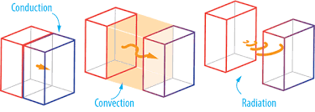



2.1. Introduction
Convection
Radiation
Conduction
2

Slide 4
2.2. Conduction
Conduction is at transfer through solids or stationery fluids. When you touch a hot object, the heat you feel is transferred through your skin by conduction.
Two mechanisms explain how heat is transferred by conduction: lattice vibration and particle collision.
Conduction through solids occurs by a combination of the two mechanisms; heat is conducted through stationery fluids primarily by molecular collisions.
In solids, atoms are bound to each other by a series of bonds, analogous to springs. When there is a temperature difference in the solid, the hot side of the solid experiences more vigorous atomic movements.
The vibrations are transmitted through the springs to the cooler side of the solid. Eventually they reach equilibrium, where all the atoms are vibrating with the same energy.
3

Slide 5
2.2. Conduction
Solids, especially metals, have free electrons, which are not bound to any particular atom and can freely move about the solid. The electrons in the hot side of the solid move faster than those on the cooler side.
As the electrons undergo a series of collisions, the faster electrons give off some of their energy to the slower electrons.
4

Slide 6
2.2. Conduction
In fluids, conduction occurs through collisions between freely moving molecules. The mechanism is identical to the electron collisions in metals.
5

Slide 7
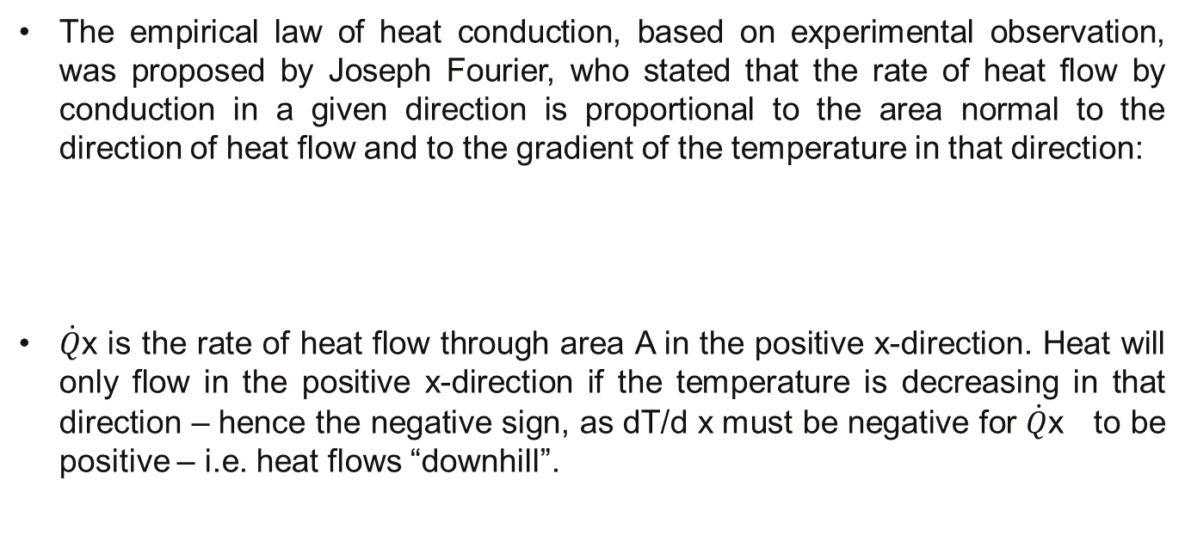
2.2. Conduction
The empirical law of heat conduction, based on experimental observation, was proposed by Joseph Fourier, who stated that the rate of heat flow by conduction in a given direction is proportional to the area normal to the direction of heat flow and to the gradient of the temperature in that direction:
$\dot{Q}$x is the rate of heat flow through area A in the positive x-direction. Heat will only flow in the positive x-direction if the temperature is decreasing in that direction – hence the negative sign, as dT/d x must be negative for $\dot{Q}$x to be positive – i.e. heat flows “downhill”.
6

Slide 8
2.2. Conduction
The proportionality constant, λ (or k as is often used) is called the thermal conductivity of the material. Good conductors have high values of λ, good insulators low values. λ has SI units W/m K, and varies from around 0.1W/m K for gases and insulating materials to up to 1000W/m K for highly conducting metals such as copper or silver.
If the temperature gradient through the material is uniform (as it would be in a slab of isotropic material) and at steady state, and the thermal conductivity does not change significantly with temperature, then Fourier’s equation can be written in its steady state form:
7

Slide 9
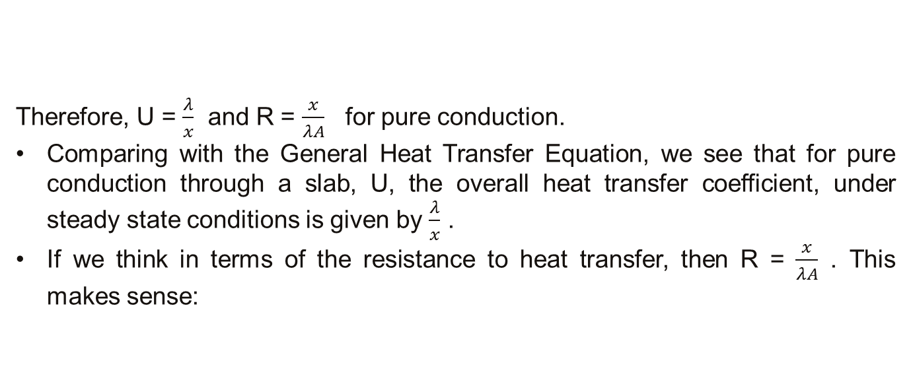
2.2. Conduction
Therefore, U = $\frac{λ}{x}$ and R = $\frac{x}{λA}$ for pure conduction.
Comparing with the General Heat Transfer Equation, we see that for pure conduction through a slab, U, the overall heat transfer coefficient, under steady state conditions is given by $\frac{λ}{x}$ .
If we think in terms of the resistance to heat transfer, then R = $\frac{x}{λA}$ . This makes sense:
8

Slide 10
2.2. Conduction
as the thickness of the wall increases, so must its resistance to heat transfer.
But if the thermal conductivity is very large, then heat is transferred easily, and the resistance to heat transfer is small.
Similarly, if the area is very large, then a lot of heat will be lost through it.
Example: Heat loss through a window.
The window in my office is (2× 3) m. Assuming all other walls are well insulated and that heat loss only occurs through the window, calculate what size of heater I need in my office to maintain the temperature, if the inside surface of the glass is at 11 ⁰C and the outside surface at 6 ⁰C. Sketch the temperature profile through the glass. Thickness of glass = 4mm Thermal conductivity of glass = 0.78W/m K.
9

Slide 11
2.2. Conduction
10

Slide 12
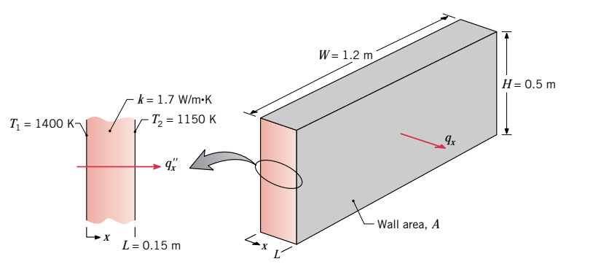
2.2. Conduction
Example: The wall of an industrial furnace is constructed from 0.15-m-thick fireclay brick having a thermal conductivity of 1.7 W/m K. Measurements made during steady state operation reveal temperatures of 1400 and 1150 K at the inner and outer surfaces, respectively. What is the rate of heat loss through a wall that is 0.5 m by 1.2 m on a side?
11

Slide 13
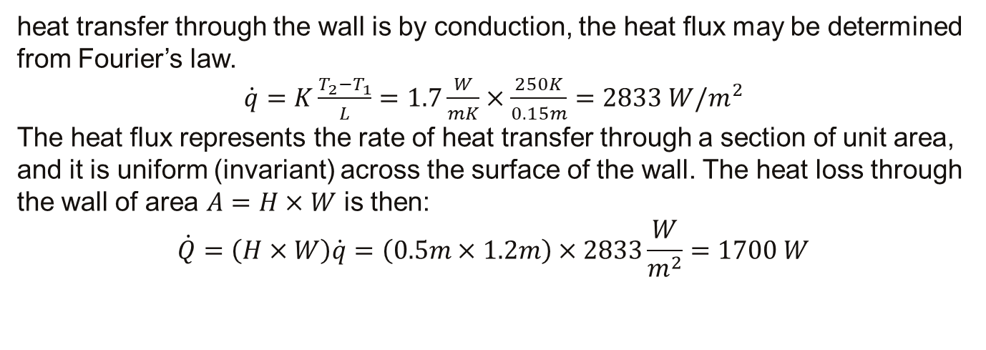
2.2. Conduction
heat transfer through the wall is by conduction, the heat flux may be determined from Fourier’s law.
$\dot{q}=K\frac{T_{2}−T_{1}}{L}=1.7\frac{W}{mK}×\frac{250K}{0.15m}=2833 W/m^{2}$
The heat flux represents the rate of heat transfer through a section of unit area, and it is uniform (invariant) across the surface of the wall. The heat loss through the wall of area $A=H×W$ is then:
$$\dot{Q}=\left(H×W\right)\dot{q}=\left(0.5m×1.2m\right)×2833\frac{W}{m^{2}}=1700 W$$
12

Slide 14
2.3. Convection
Convection is the mechanism of heat transfer between a flowing fluid and a solid body (or between a gas and a liquid at rest). Imagine a fluid flowing past a solid wall.
Clearly there will be a temperature profile between the bulk fluid and the wall – in the bulk the fluid will be fairly uniformly at its bulk average temperature, Tf , and near the wall it will approach the wall temperature, Tw.
13

Slide 15
2.3. Convection
Imagine now a layer near the wall in which the temperature varies between Tw and T_{f} . If we were to consider heat conduction in this layer, we could describe it by:
where λ_{t} is the thermal conductivity of the liquid layer near the wall, and δ the thickness of our imaginary layer. The trouble is, we don’t know the value of either λ_{t} or δ, and both will change depending on the fluid and the flow conditions. So as we don’t know either, we may as well replace them both by a single term, which we will call the convective heat transfer coefficient, h:
14

Slide 16
2.3. Convection
To be dimensionally correct, h must have SI units of W/m² K. These are the same units as U; clearly, for pure convection, U is equal to h. The resistance to heat transfer by convection is given by R = 1/ hA.
The convective heat transfer coefficient varies with the type of flow (turbulent or laminar), the geometry of the system, the physical properties of the fluid, the average temperature, the position along the surface of the body, and time. So calculating h is quite complicated.
We will consider ways to calculate it later in the course.
h also depends on whether the heat transfer is by forced convection or free convection.
15

Slide 17
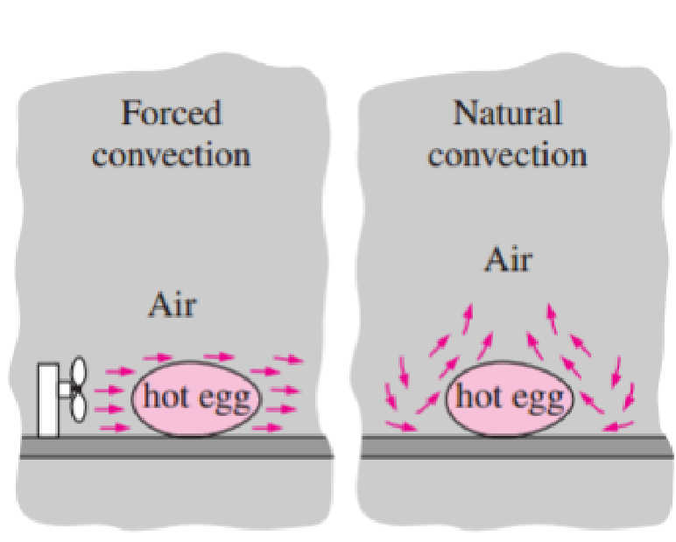
2.3. Convection
Free (or natural) convection arises when the fluid motion is caused by buoyancy effects caused by density differences caused by temperature differences in the fluid. So a hot plate suspended in air causes the immediately adjacent air to heat up; this air rises, giving fluid motion relative to the solid plate.
Forced convection, by contrast, arises when the fluid motion is artificially induced, e.g. by a pump or a fan which forces the fluid to flow over the surface of the solid.
16

Slide 18
2.3. Convection
To summarise, the convective heat transfer coefficient, h, is affected by the fluid mechanics of the system, so is somewhat difficult to determine – once known, however, it is easy to use.
Table 1 shows typical values of h. Note that these values differ by 4 􀀀 5 orders of magnitude. In practice, this means that if you have a wall with convective heat transfer on both sides, often the coefficient on one side will be the controlling one.
Note too that condensing steam uses a heat transfer coefficient in the same way and with the same units, although the mechanism of heat transfer is not quite the same (involving phase change rather than conduction through an imaginary thin layer of fluid near the wall).
17

Slide 19
2.3. Convection
The very high value of heat transfer coefficient for condensing steam is one reason that steam is a popular heat transfer fluid in the process industries. The two other major reasons are:
condensing steam has a very high latent heat of condensation, so delivers a lot of heat
the temperature at which the steam condenses can be easily controlled by changing the pressure
Additional, more minor, reasons include: steam is cheap, non-toxic, environmentally friendly
18

Slide 20
2.3. Convection
Example: Steam condenses on the inside of an insulated pipe 10m in length and with outer diameter 5 cm. Heat is lost at a rate of 900W to the external air at 15 ⁰C with a convective heat transfer coefficient of 20 W/m² K. Calculate the temperature of the outer surface of the pipe.
19

Slide 21


