Slide 1



Heat Transfer by Conduction UNIT 3
University of Mosul
Collage of Science
Department of New and Renewable Energies
By:
Dr. Ghada Ghanim Younis
Ms. Zainab Abdulazeez Jameel

Slide 2
3.1. Derivation of one-dimensional conduction heat transfer equation
To do this we will develop the basic mathematical equation which describes the temperature distribution through a system. We will do this based on the energy conservation equation, which we will apply to a very small element.
As we noted earlier when we were considering energy balances, conservation of energy applies whether we are considering a whole plant, a single item of equipment, or a small differential element within some equipment.
Here we are going to consider conservation of energy over a small differential element.
To simplify the mathematical notation, and to illustrate the meaning of the terms in the equation, we will start by considering just one-dimensional conduction.
1

Slide 3
3.1. Derivation of one-dimensional conduction heat transfer equation
This would apply when considering, for example, conduction through a wall where the height and width of the wall are very large compared with its thickness, so that essentially there is no difference in temperature along the height or width, and the only difference to be considered is that across the thickness of the wall.
So, considering one-dimensional heat conduction in the x-dimension, consider a volume element of thickness Δx and area normal to the x-direction.
2

Slide 4
3.1. Derivation of one-dimensional conduction heat transfer equation
An energy balance for this volume element is stated as:
Note that this energy balance does not assume steady state, and it includes the possibility of energy generation.
This energy generation could arise from, for example, electrical resistance, nuclear reaction, or chemical reaction. Each of the terms I, II and III will be considered in turn.
3

Slide 5
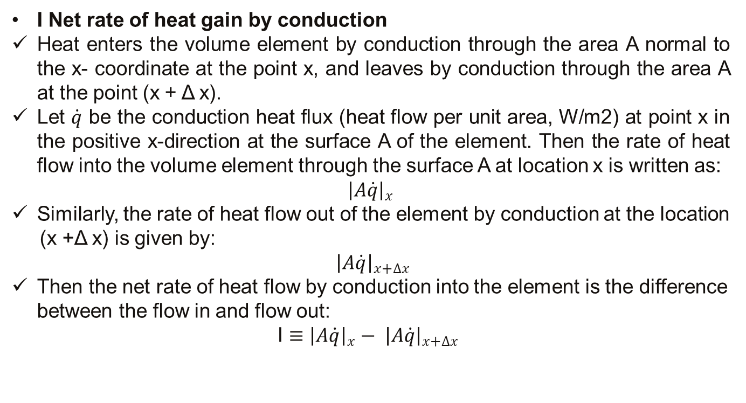
3.1. Derivation of one-dimensional conduction heat transfer equation
I Net rate of heat gain by conduction
Heat enters the volume element by conduction through the area A normal to the x- coordinate at the point x, and leaves by conduction through the area A at the point (x + Δ x).
Let $\dot{q}$ be the conduction heat flux (heat flow per unit area, W/m2) at point x in the positive x-direction at the surface A of the element. Then the rate of heat flow into the volume element through the surface A at location x is written as:
$${\left|A\dot{q}\right|}_{x}$$
Similarly, the rate of heat flow out of the element by conduction at the location
(x +Δ x) is given by:
${\left|A\dot{q}\right|}_{x+∆x}$
Then the net rate of heat flow by conduction into the element is the difference between the flow in and flow out:
I $≡{\left|A\dot{q}\right|}_{x}− {\left|A\dot{q}\right|}_{x+∆x}$
4

Slide 6
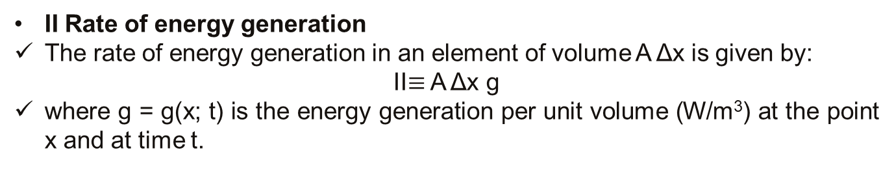
3.1. Derivation of one-dimensional conduction heat transfer equation
II Rate of energy generation
The rate of energy generation in an element of volume A Δx is given by:
II$≡$ A Δx g
where g = g(x; t) is the energy generation per unit volume (W/m³) at the point x and at time t.
5

Slide 7
3.1. Derivation of one-dimensional conduction heat transfer equation
III Rate of increase of internal energy
The relationship between the rate of energy input into a mass of material and the rate of energy change is given by:
Note that we use the partial derivative, δ, as we are considering in the term the change in temperature with respect to time, but not distance.
6

Slide 8
3.1. Derivation of one-dimensional conduction heat transfer equation
7

Slide 9
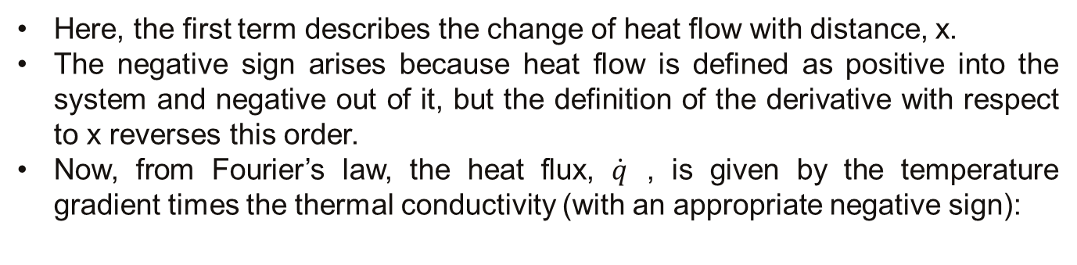
3.1. Derivation of one-dimensional conduction heat transfer equation
Here, the first term describes the change of heat flow with distance, x.
The negative sign arises because heat flow is defined as positive into the system and negative out of it, but the definition of the derivative with respect to x reverses this order.
Now, from Fourier’s law, the heat flux, $\dot{q}$ , is given by the temperature gradient times the thermal conductivity (with an appropriate negative sign):
8

Slide 10
3.1. Derivation of one-dimensional conduction heat transfer equation
This is the general heat conduction equation. The first term represents the net rate at which heat flows by conduction into the system.
Heat flows by conduction only when there is a temperature gradient, so this term includes, inside the brackets, the temperature gradient, without which there would be no flow of heat through the system at all.
But if there were no difference in the rate of flow of energy into and out of the system by conduction, there would be no accumulation, so the temperature would not change.
This is why there is an additional differentiation with respect to x.
If there is a difference (i.e. this differential is not equal to 0), it will show up as an accumulation within the system, so the temperature would change with time. This is shown by the term on the right hand side.
9

Slide 11
3.1. Derivation of one-dimensional conduction heat transfer equation
If there were internal energy generation somehow, this would also cause the temperature to change with time.
So the two terms on the left are potential sources by which the temperature might change with time, and the term on the right describes the rate at which the temperature would change with time due to these sources.
Now, you might say that the area in the first term doesn’t change with distance in the x direction, so we could take it out of the differential and cancel it with the 1/A.
And you would be right, for rectangular co-ordinates. But what about cylindrical or spherical coordinates? In these cases, area does change with distance. So let’s take our general equation and write it out for all three co-ordinate systems.
10

Slide 12
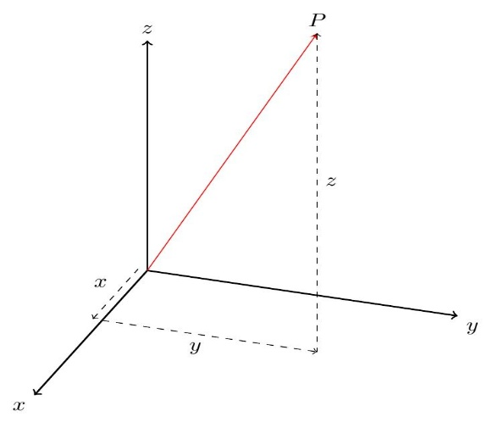
3.1.1 Rectangular Coordinates
These are our familiar, Cartesian, x, y, z coordinates, and in this system of coordinates, area normal to the x-direction does not change as x increases. So A in the general equation is constant, and the equation simplifies to:
11

Slide 13
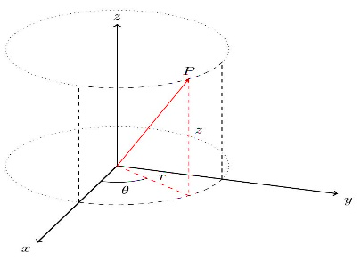
3.1.2 Cylindrical Coordinates
In cylindrical co-ordinates our three axes are given by r, ‑, and z, and for one-dimensional heat conduction we are concerned with conduction in the radial direction, r.
Area increases proportionally with r, so the general equation becomes:
12

Slide 14


