Slide 1



Heat Transfer by Convection UNIT 4
University of Mosul
Collage of Science
Department of New and Renewable Energies
By:
Dr. Ghada Ghanim Younis
Ms. Zainab Abdulazeez Jameel

Slide 2
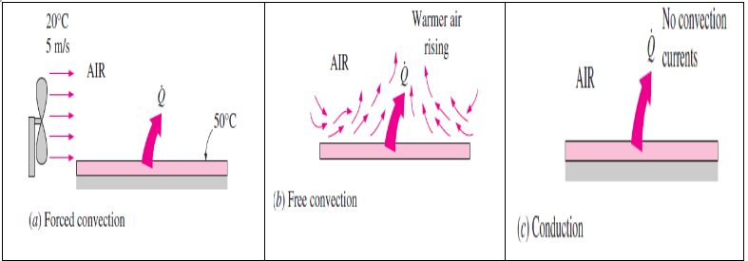
4.1 Physical mechanism of convection
Heat transfer in solids occurs only by conduction, as molecules remain fixed in position. In fluids (liquids and gases), heat transfer may occur by conduction (if the fluid is stationary) or by convection (if there is bulk fluid motion).
Thus, conduction in fluids can be considered a limiting case of convection when the fluid is at rest.
1

Slide 3
4.1 Physical mechanism of convection
Convection depends on several variables: fluid properties (viscosity, conductivity, density, specific heat), velocity, surface geometry, roughness, and flow regime (laminar or turbulent).
Despite its complexity, convection heat transfer is practically described by Newton’s law of cooling:
2

Slide 4
4.1 Physical mechanism of convection
The convection heat transfer coefficient h can be defined as the rate of heat transfer between a solid surface and a fluid per unit surface area per unit temperature difference.
h depends on the several of the mentioned variables, and thus is difficult to determine.
When a fluid flows over a solid surface, the no-slip condition means that the fluid in direct contact with the surface has zero velocity relative to it, due to viscosity.
This creates a velocity profile, since each layer of fluid slows the next through friction.
Similarly, the no-temperature-jump condition means the fluid and solid surface at the point of contact have the same temperature.
3

Slide 5
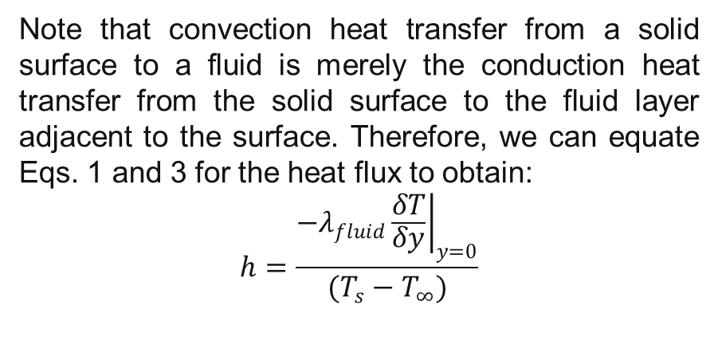
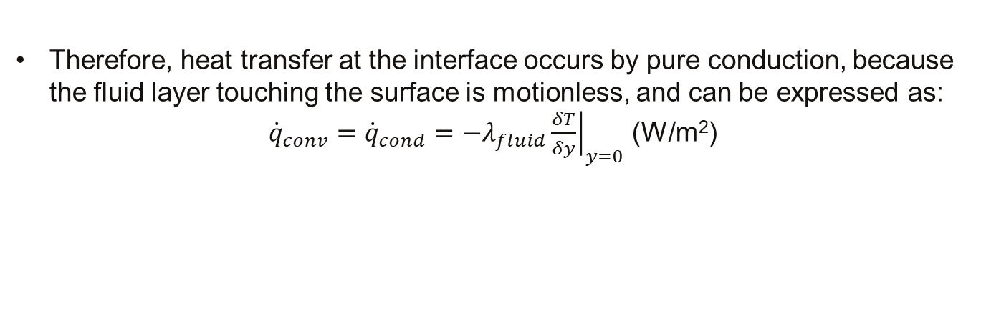
4.1 Physical mechanism of convection
Therefore, heat transfer at the interface occurs by pure conduction, because the fluid layer touching the surface is motionless, and can be expressed as:
${\dot{q}}_{conv}={\dot{q}}_{cond}=−λ_{fluid}{\left.\frac{δT}{δy}\right|}_{y=0}$ (W/m²)
Note that convection heat transfer from a solid surface to a fluid is merely the conduction heat transfer from the solid surface to the fluid layer adjacent to the surface. Therefore, we can equate Eqs. 1 and 3 for the heat flux to obtain:
$$h=\frac{−λ_{fluid}{\left.\frac{δT}{δy}\right|}_{y=0}}{(T_{s}−T_{∞})}$$
4

Slide 6
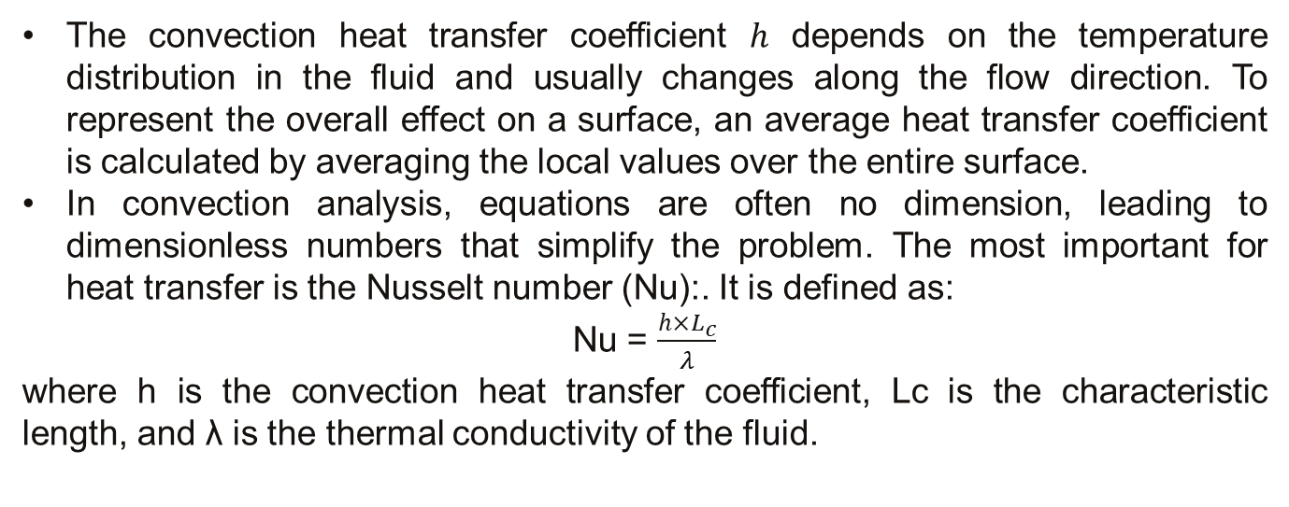
4.1 Physical mechanism of convection
The convection heat transfer coefficient ℎ depends on the temperature distribution in the fluid and usually changes along the flow direction. To represent the overall effect on a surface, an average heat transfer coefficient is calculated by averaging the local values over the entire surface.
In convection analysis, equations are often no dimension, leading to dimensionless numbers that simplify the problem. The most important for heat transfer is the Nusselt number (Nu):. It is defined as:
Nu = $\frac{h×L_{c}}{λ}$
where h is the convection heat transfer coefficient, Lc is the characteristic length, and λ is the thermal conductivity of the fluid.
5

Slide 7
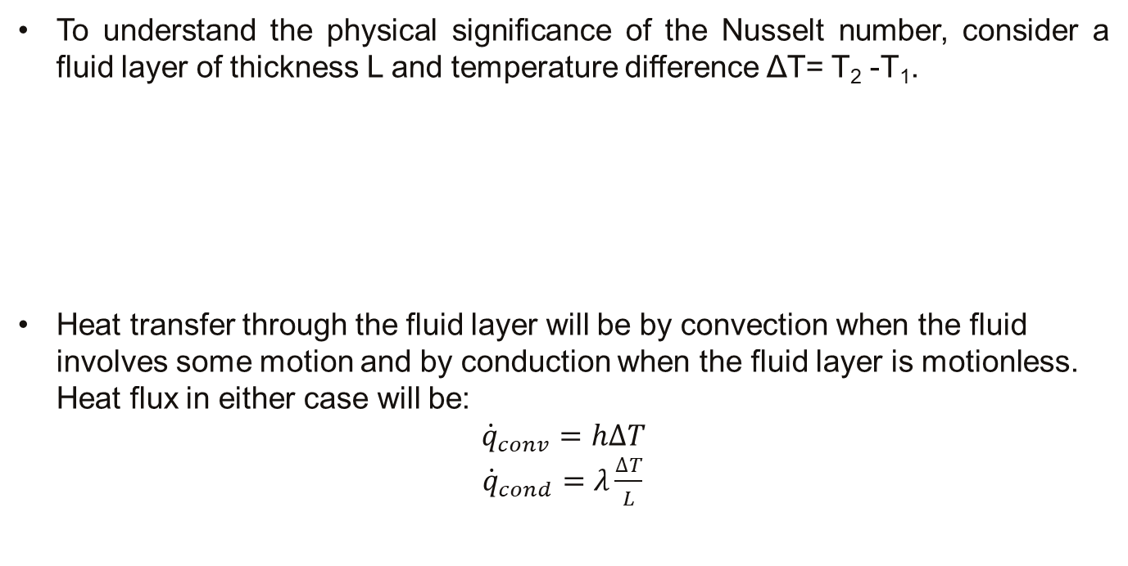
4.1 Physical mechanism of convection
To understand the physical significance of the Nusselt number, consider a fluid layer of thickness L and temperature difference ΔT= T₂ -T₁.
Heat transfer through the fluid layer will be by convection when the fluid involves some motion and by conduction when the fluid layer is motionless. Heat flux in either case will be:
$${\dot{q}}_{conv}=h∆T$$
${\dot{q}}_{cond}=λ\frac{∆T}{L}$
6

Slide 8
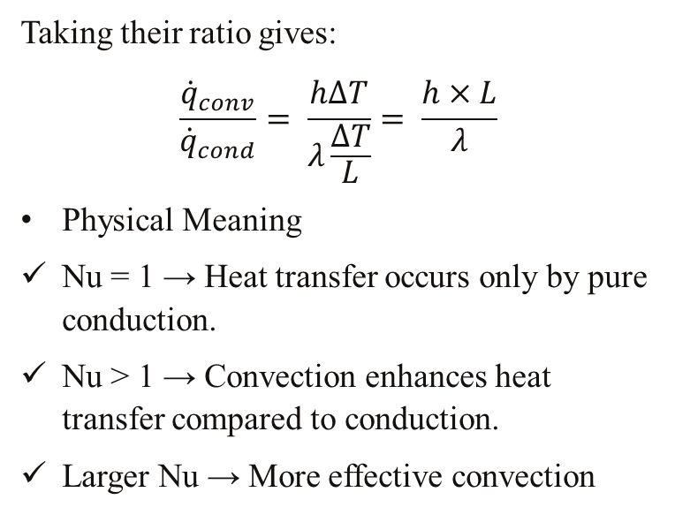
4.1 Physical mechanism of convection
Taking their ratio gives:
$$\frac{{\dot{q}}_{conv}}{{\dot{q}}_{cond}}= \frac{h∆T}{λ\frac{∆T}{L}}= \frac{h×L}{λ}$$
Physical Meaning
Nu = 1 → Heat transfer occurs only by pure conduction.
Nu > 1 → Convection enhances heat transfer compared to conduction.
Larger Nu → More effective convection
7

Slide 9
4.2 Thermal Boundary Layer
In Fluid Mechanics, you learned about the concept of a velocity boundary layer, which was the layer of fluid flowing near to the wall, in which the velocity of the fluid increased from zero at the wall up to close to the free stream velocity of the fluid far from the wall.
Analogous to this idea, we can imagine the development of a thermal boundary layer, in which the temperature of a fluid flowing past a wall varies from the wall temperature to the bulk fluid temperature.
Note that x represents direction along the wall surface, and y direction normal to the wall.
8

Slide 10
4.2 Thermal Boundary Layer
The thermal boundary layer is the place of points at which the temperature is equal to 99 the bulk fluid temperature, i.e. T (x, y) = 0.99T∞ at t(x).
The thicknesses of the thermal boundary layer and the velocity boundary layer are not necessarily the same! The relative thickness depends on the Prandtl number, which is a dimensionless number
9

Slide 11
4.2 Thermal Boundary Layer
The Prandtl number is a measure of the ratio of momentum diffusivity to heat diffusivity. If this ratio is equal to unity, as it is for gases, then the thermal and velocity boundary layers have the same thickness, i.e.
For fluids for which Pr <<1, such as liquid metals, the thermal boundary layer is much thicker than the velocity boundary layer i.e. heat is propagated through the fluid to a greater than momentum.
For fluids for which Pr >> 1, such as ordinary liquids and oils, the thermal boundary layer is much thinner than the velocity boundary layer.
10

Slide 12


